Slide 1
Campus Exchange
A Second-hand Trading App
CS673 Software Engineering Iteration 3
Team2: Scrumble Bug
Date: Dec 5 2024

Slide 2
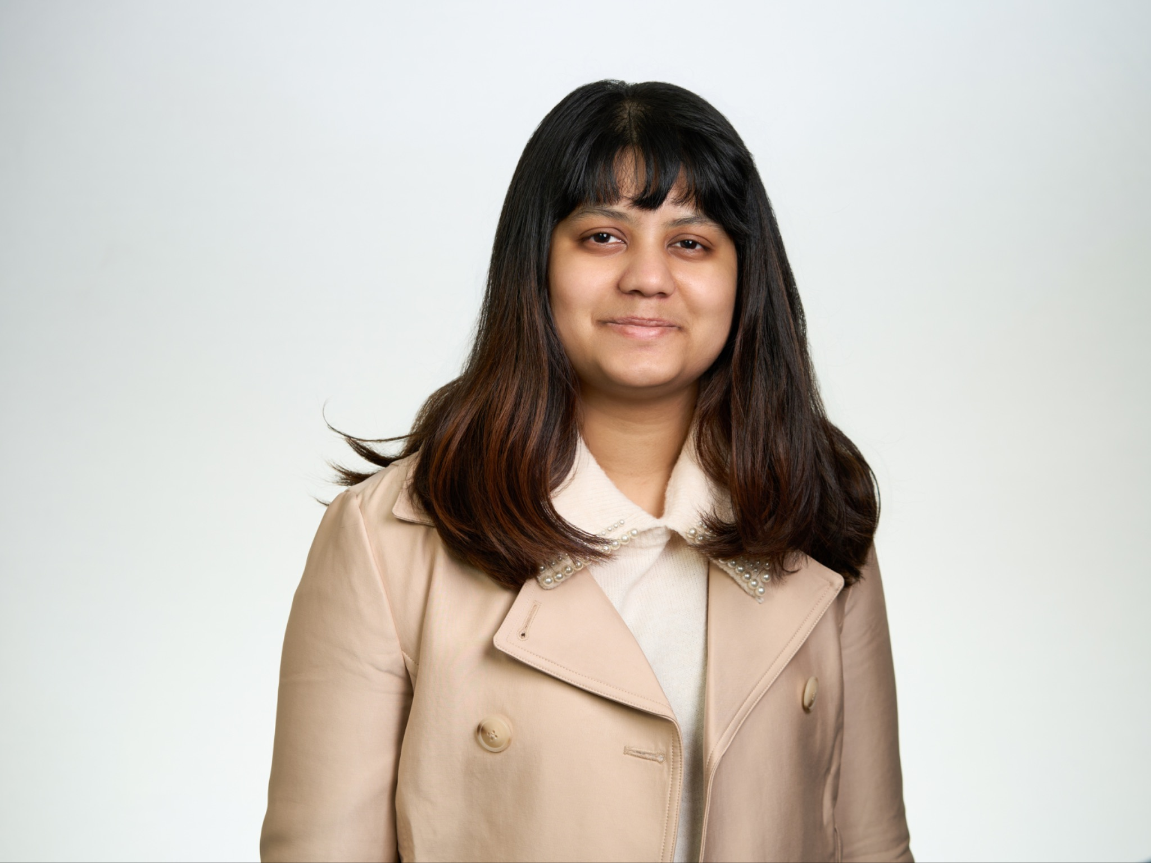
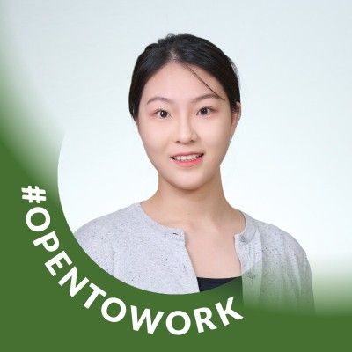

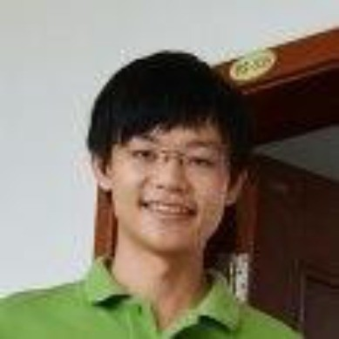
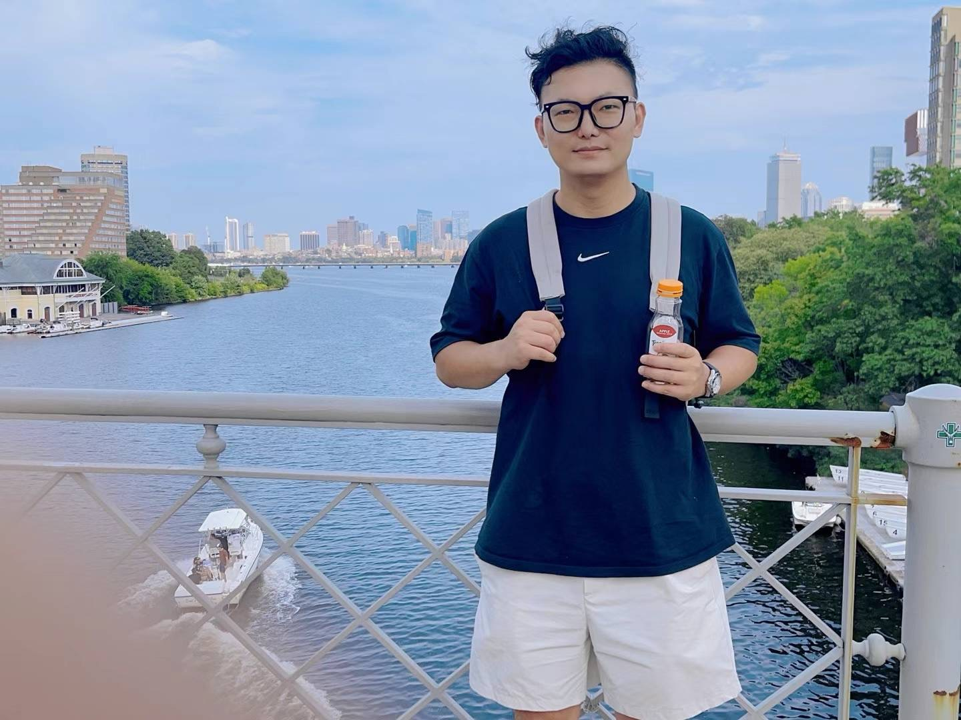
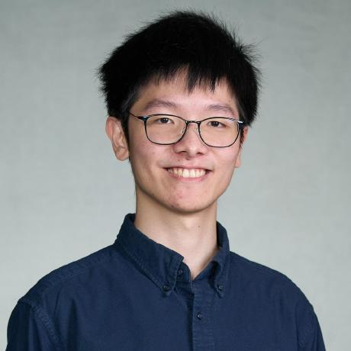
Team Building
Srujana N
QA Leader
Yueyihan Qi
Security Leader
Yingtong Zhou
Team Leader
Yuanbin Man
Requirement Leader
Ang Li
Design and Implementation Leader
HungHsu Chen
Configuration Leader

Slide 3
Agenda
Project Overview
User Story
Project fulfillment
System Design
Deployment CI/CD
Testing
Security

Slide 4
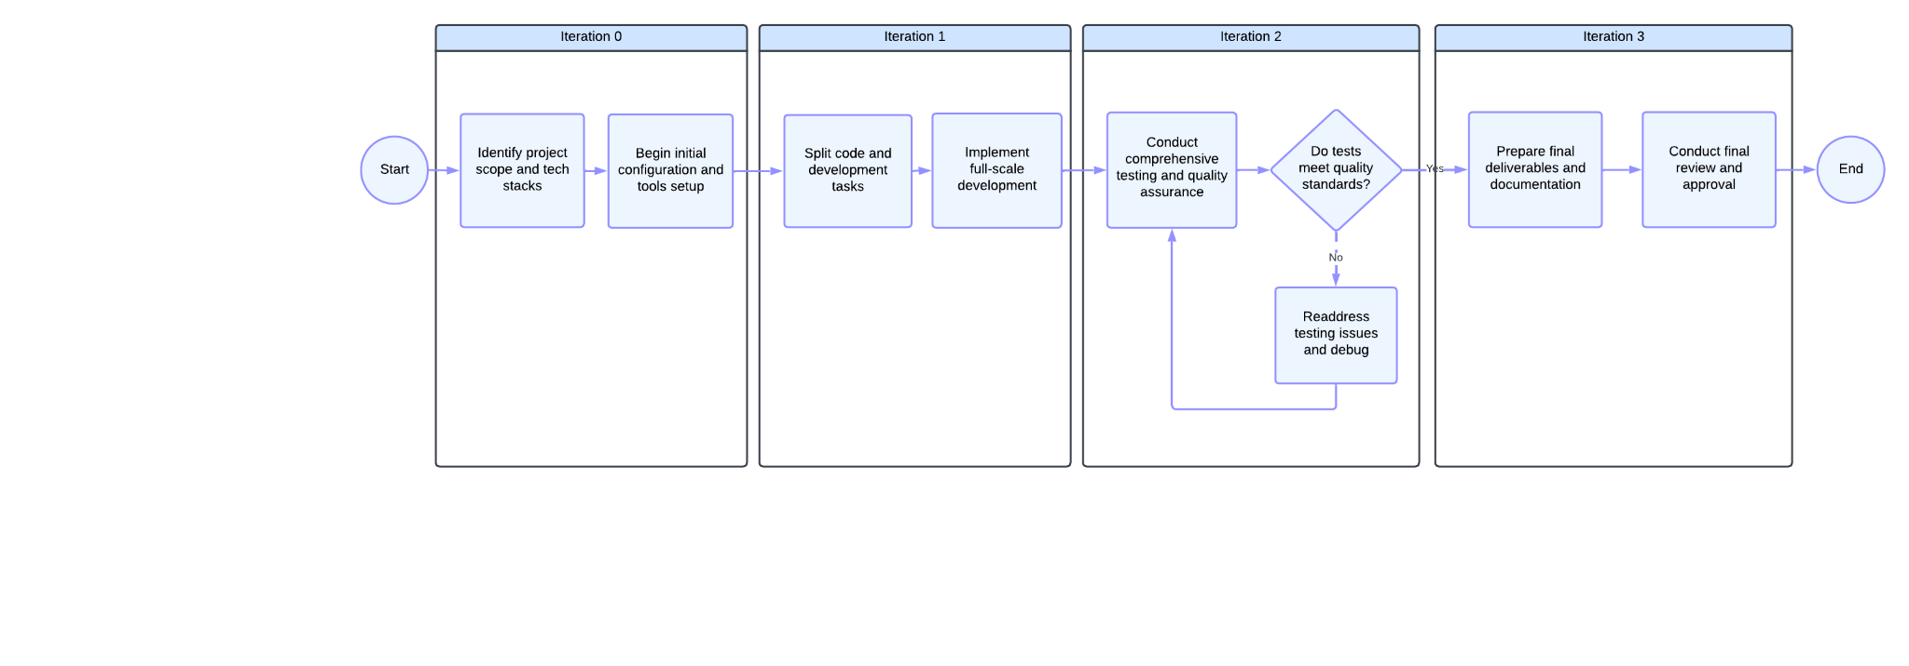
Project Overview @Yingtong
Campus Exchange
A peer-to-peer platform for BU students to buy and sell used items within campus.
Notes:
In iteration 3, we focused on the CRUD of products and orders, and implemented the comments and message functionalities. Demo

Slide 5
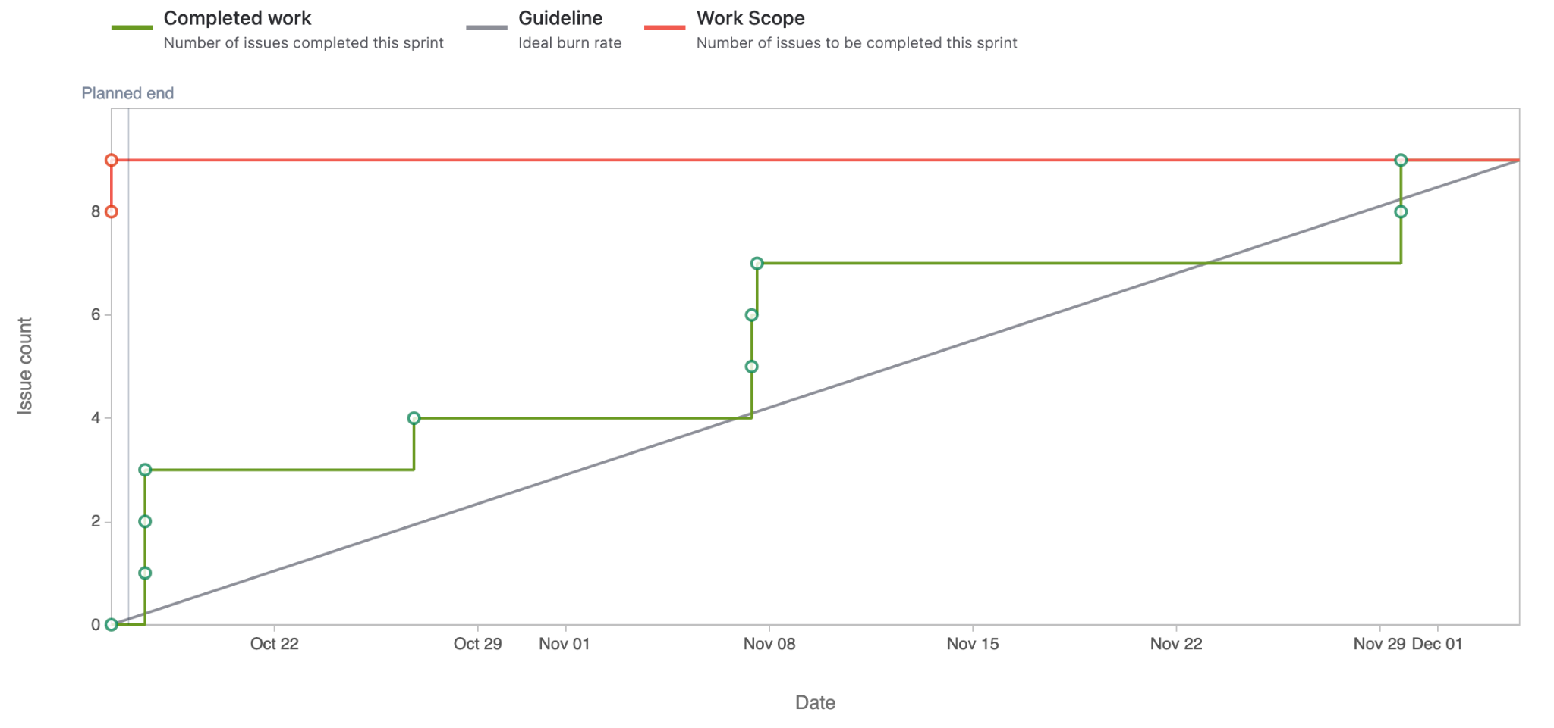
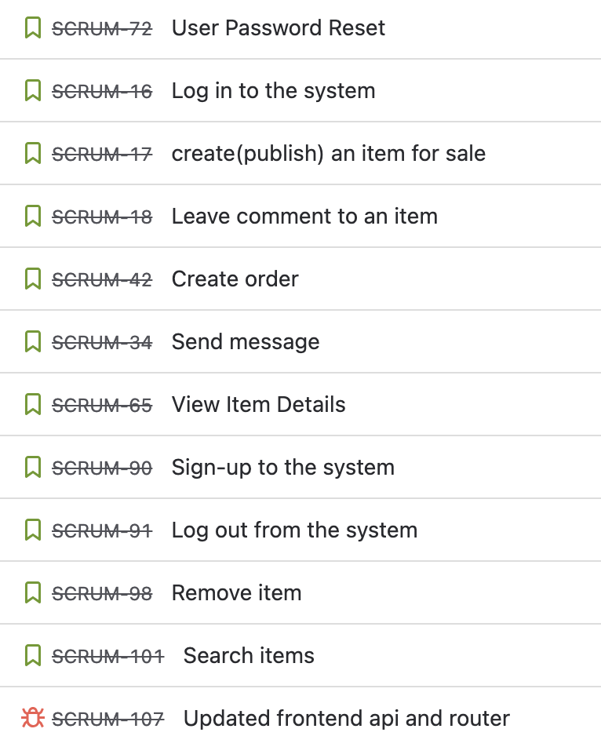
User Story @Yingtong
User stories finished: 12
Story points gained: 54
https://bu-cs673f24a2team2.atlassian.net/jira/software/projects/SCRUM/boards/1/reports/burnup
Notes:
user authentication and email verification; CRUD of products and orders; comments and message functionalities

Slide 6

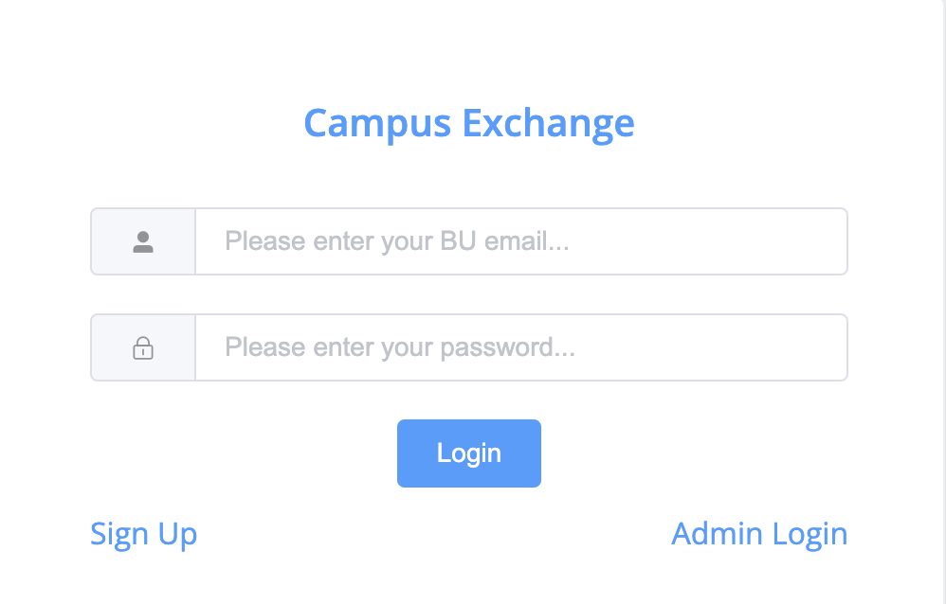
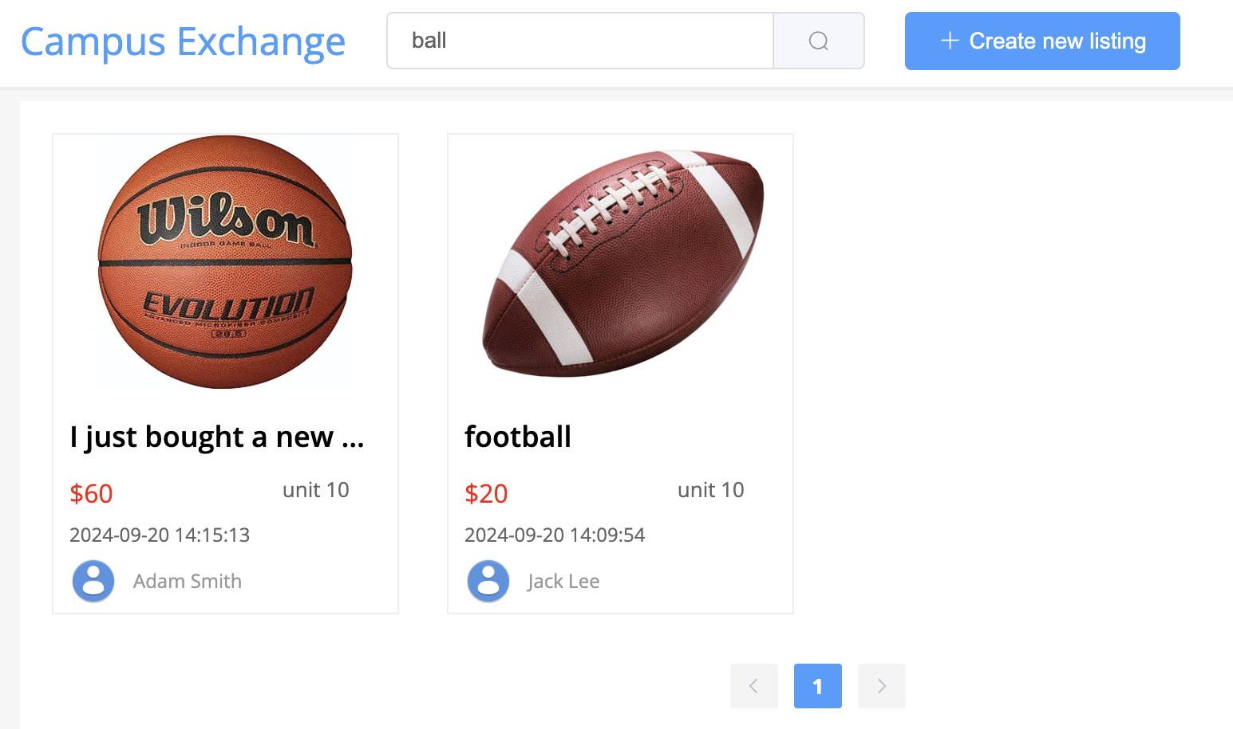
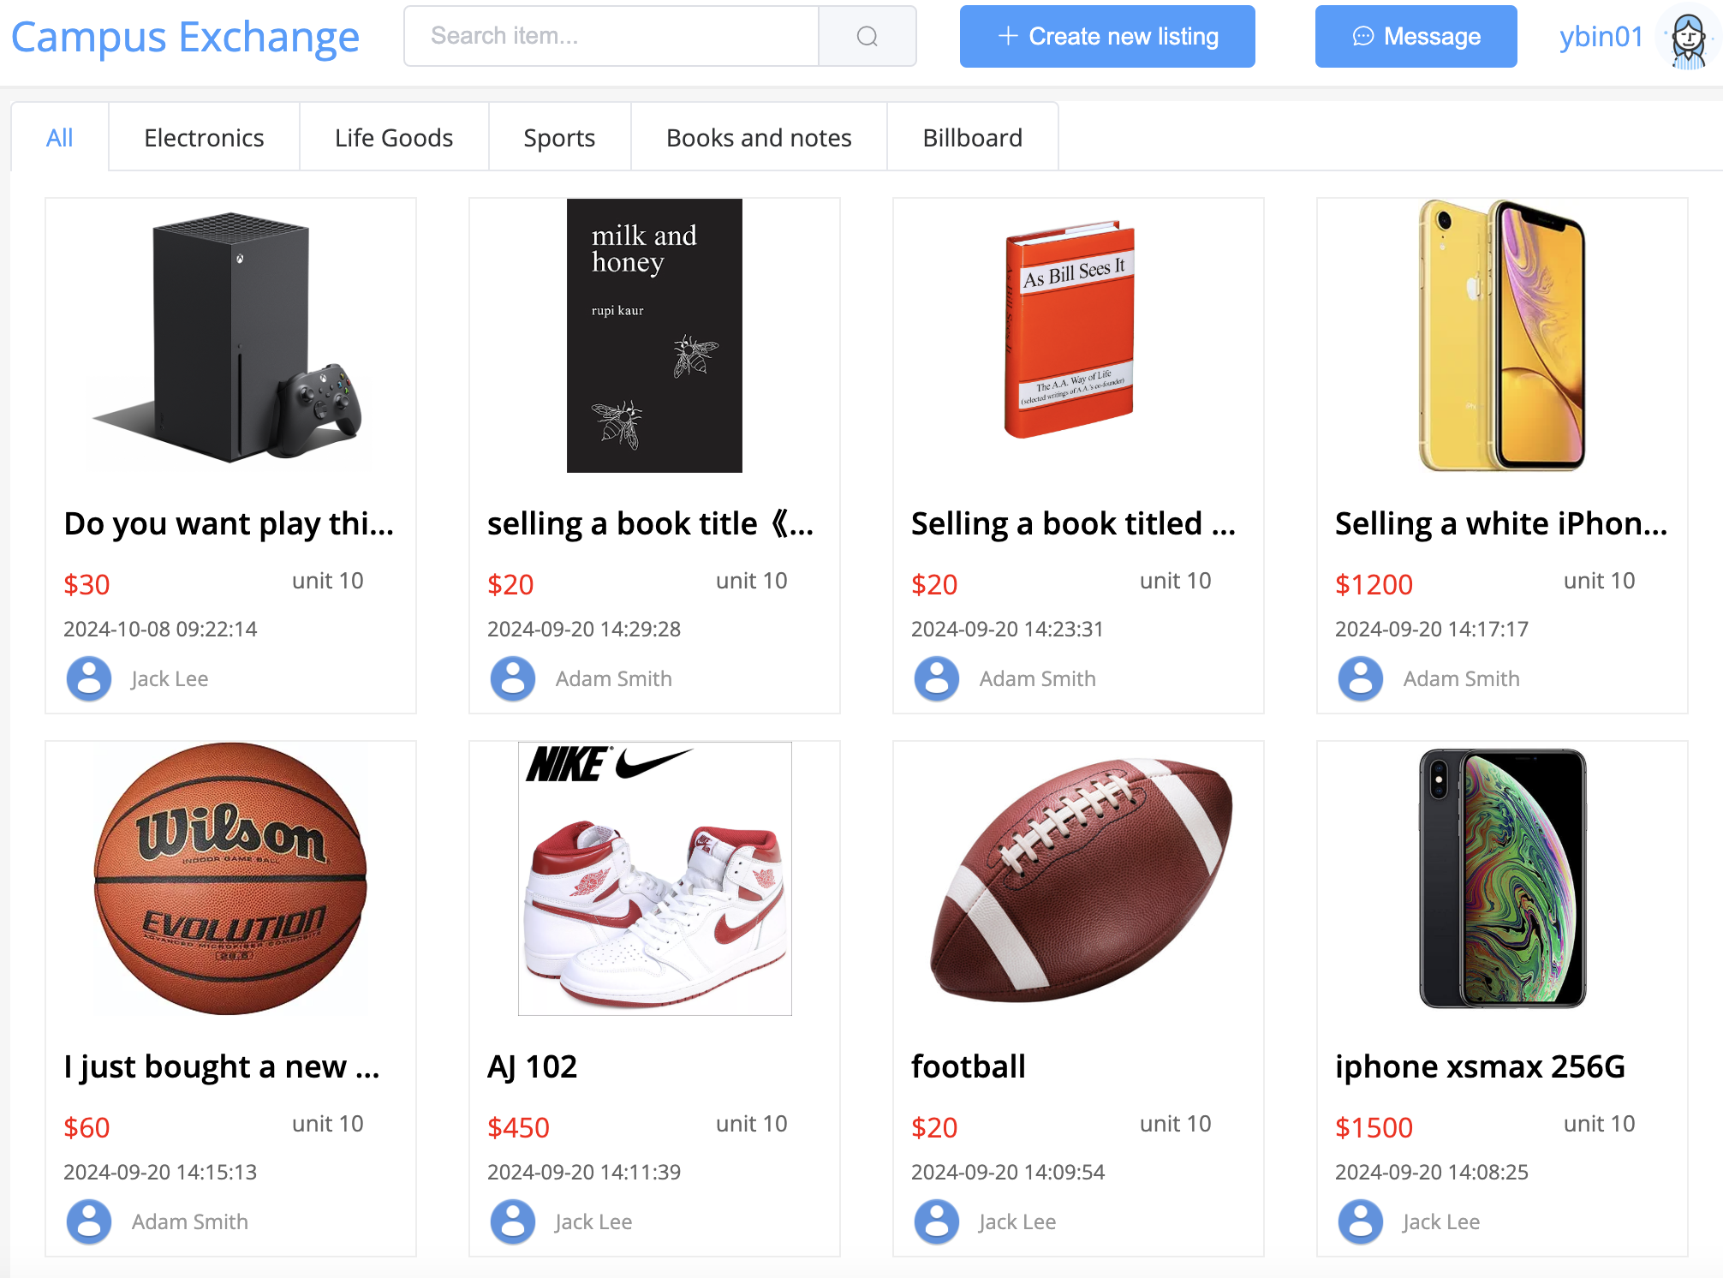
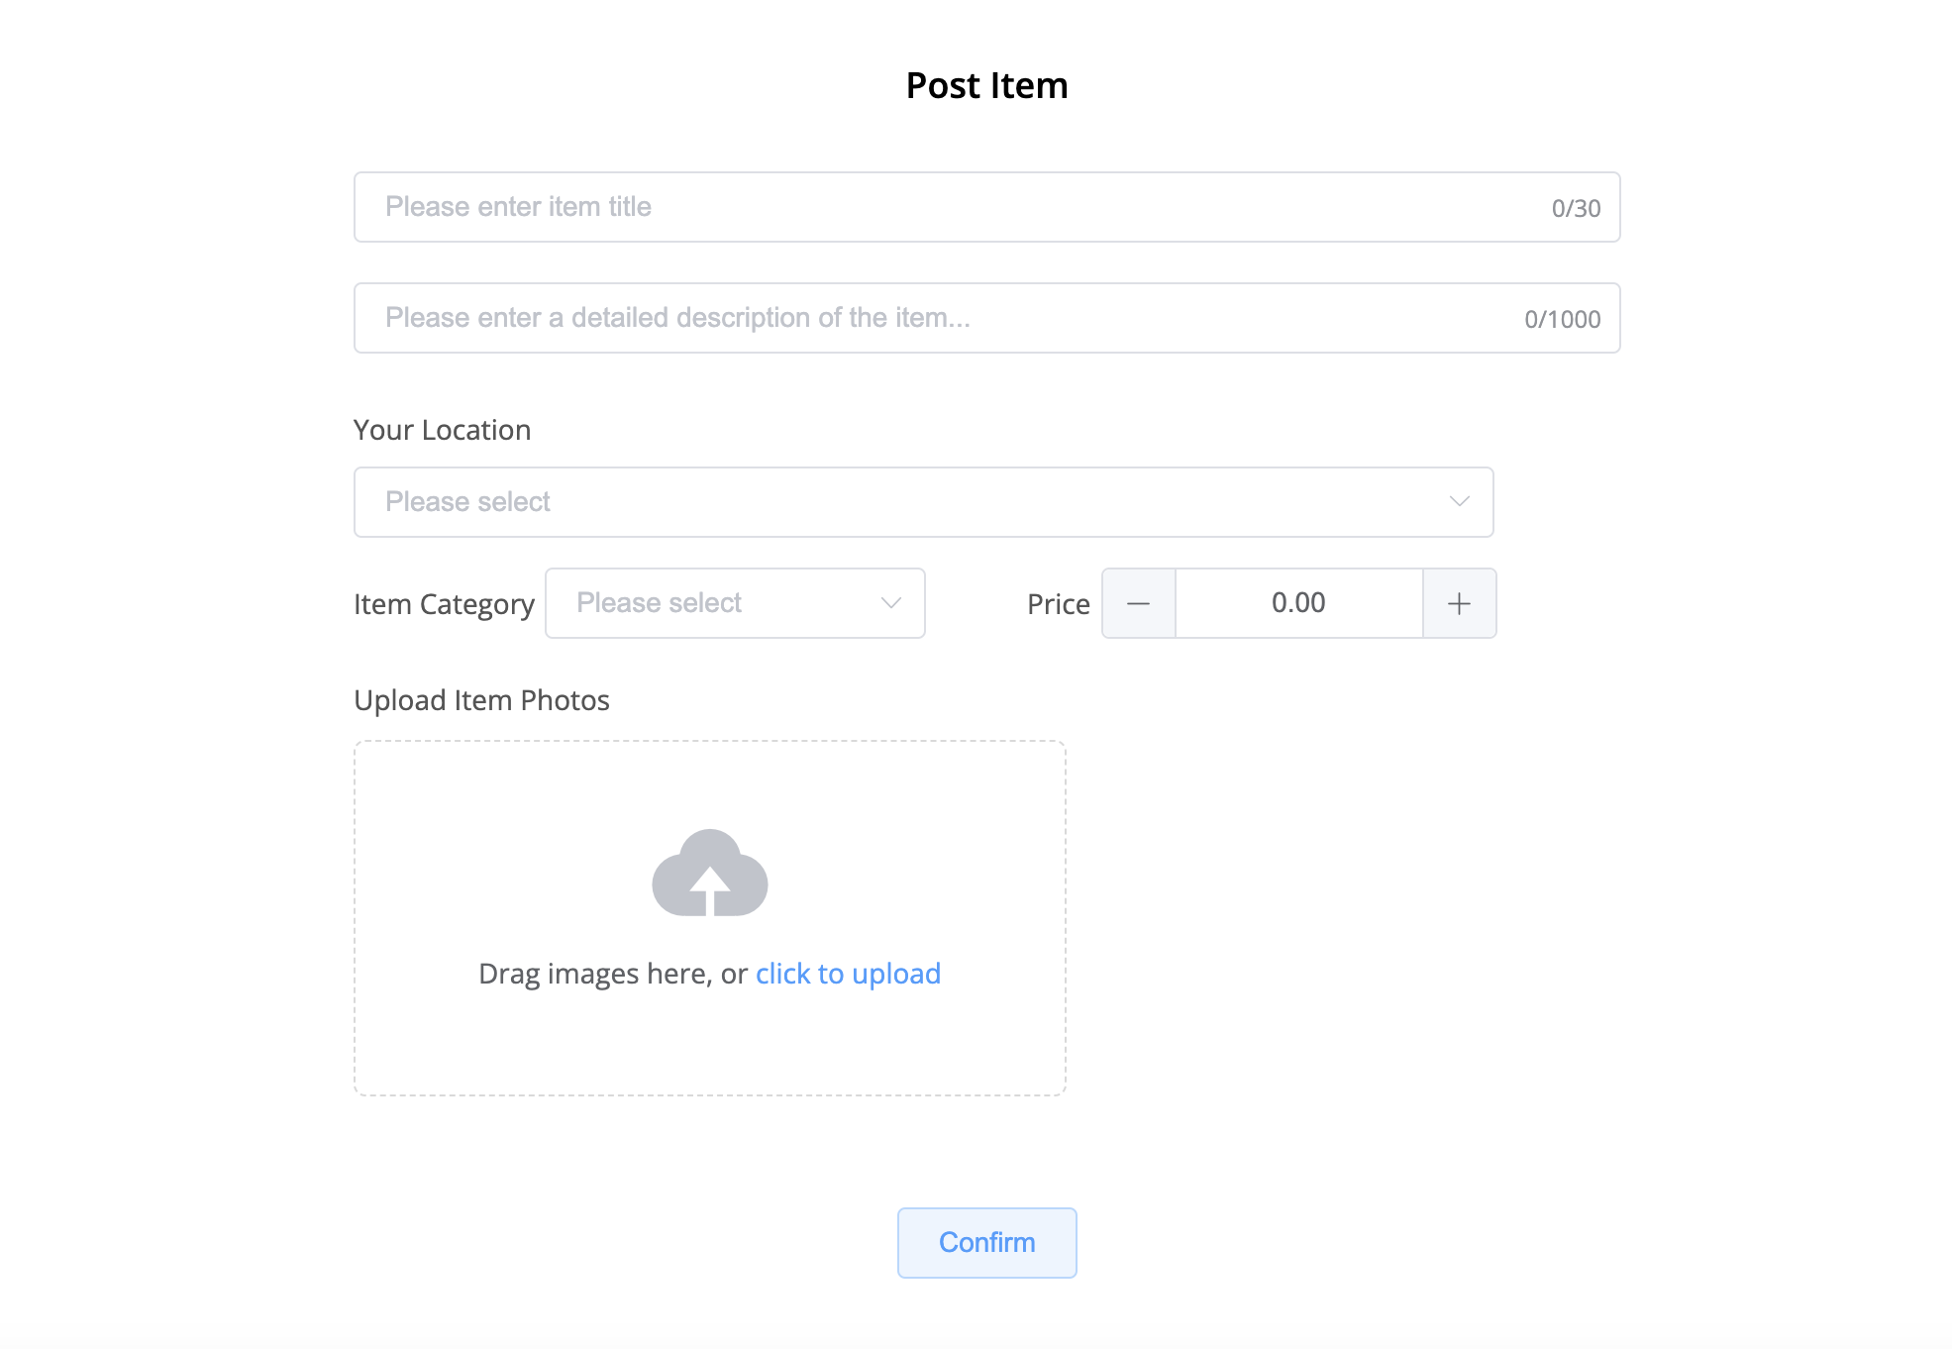
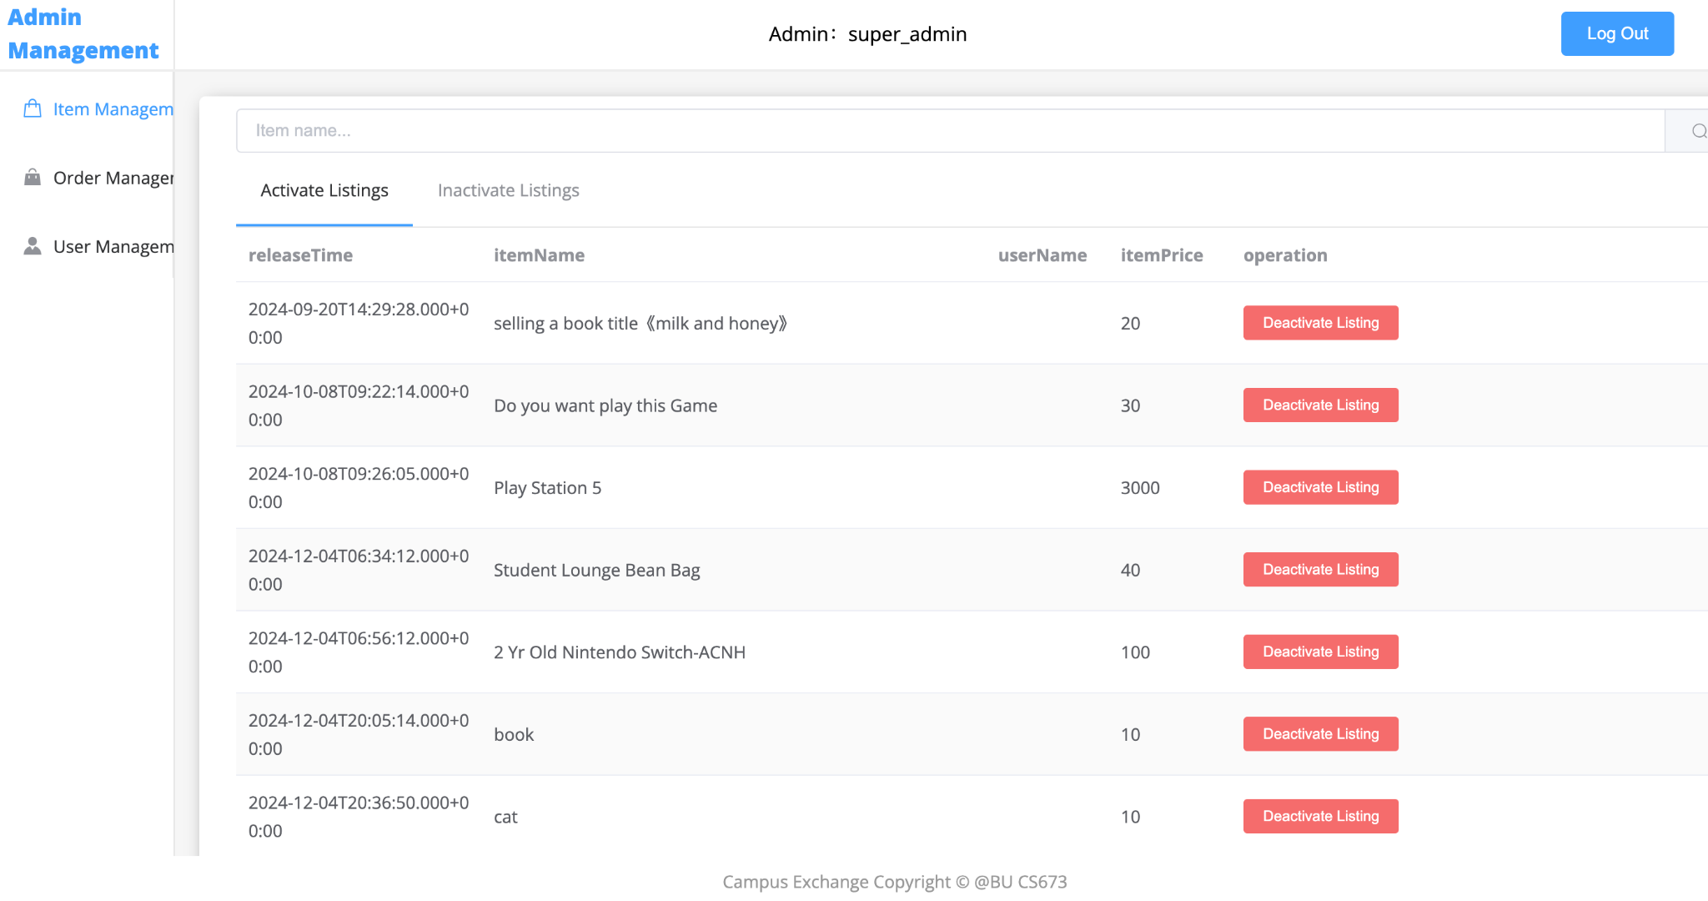
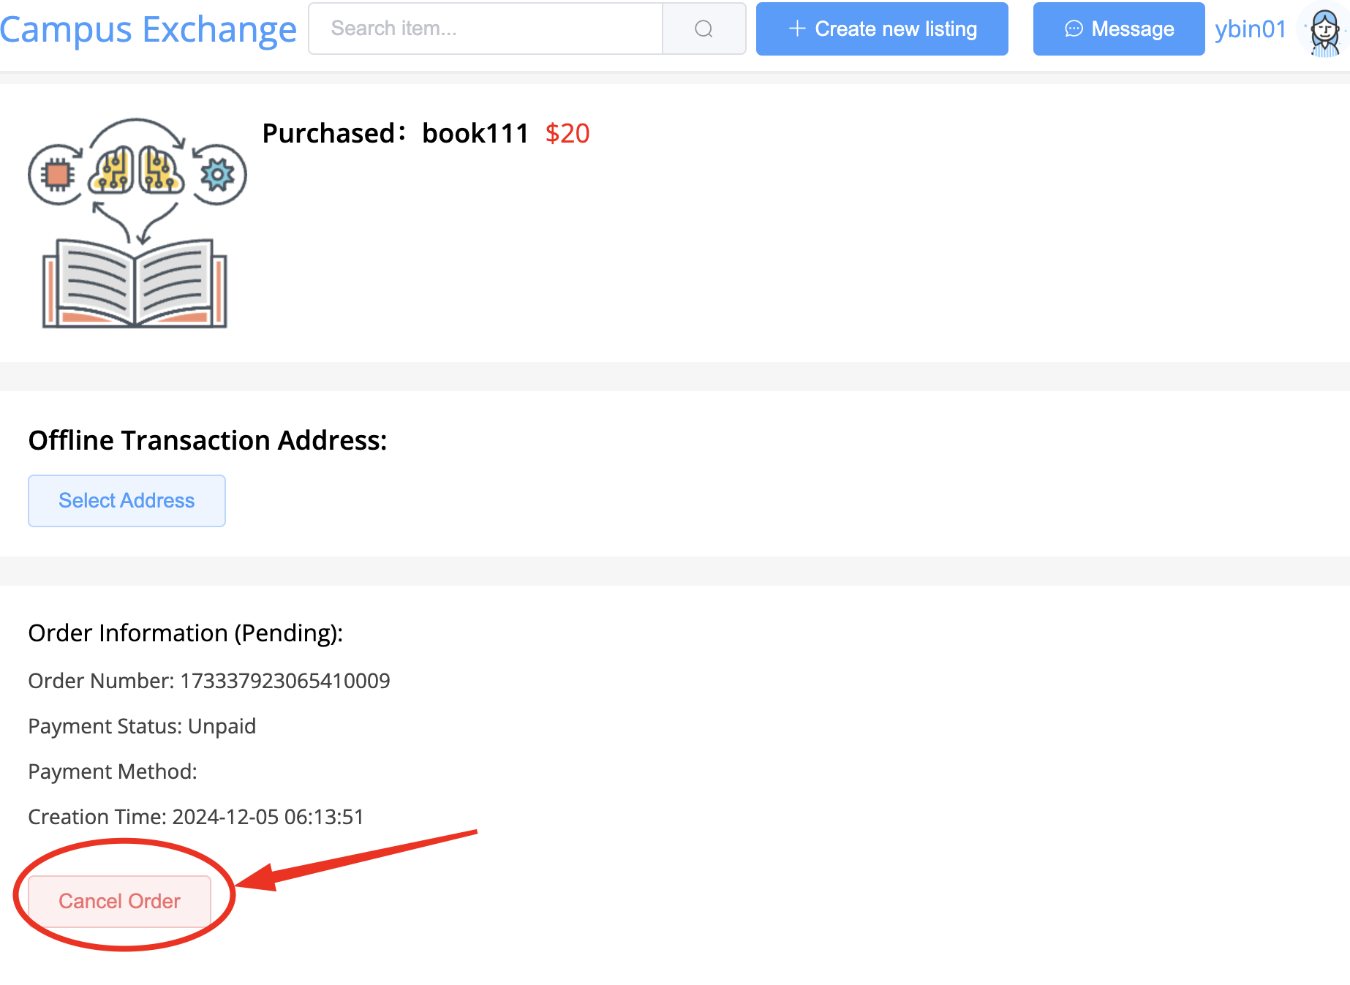
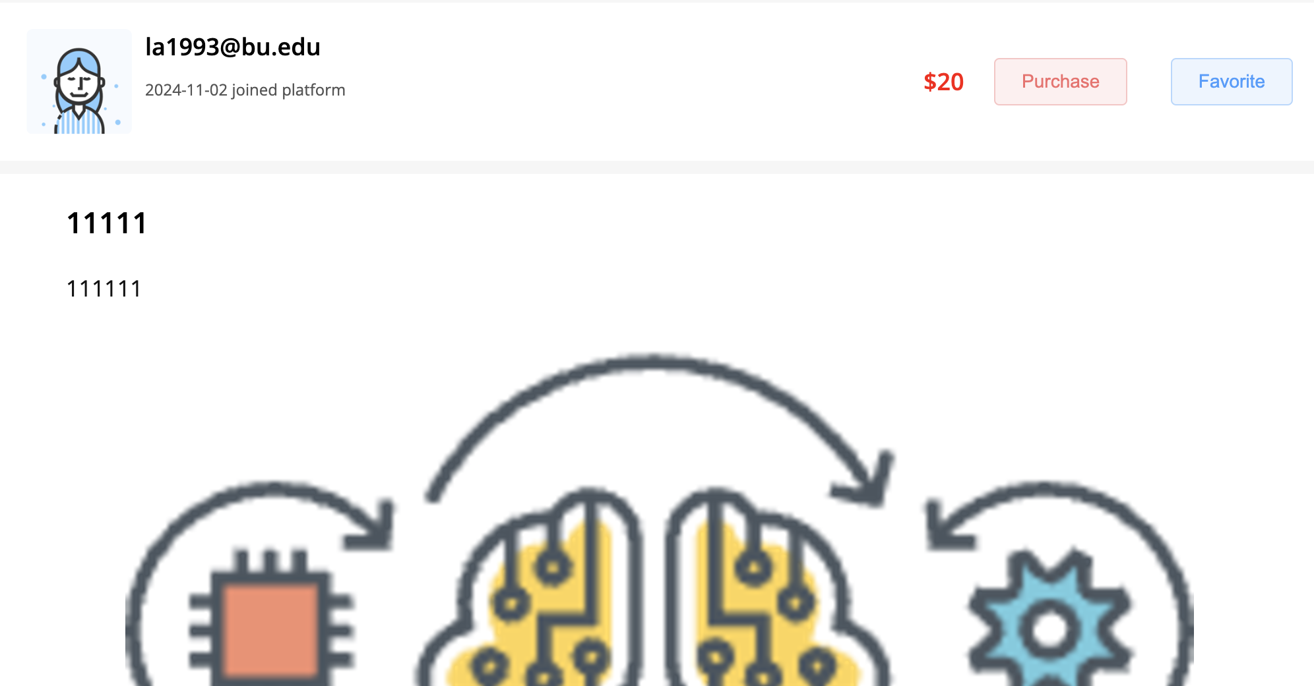
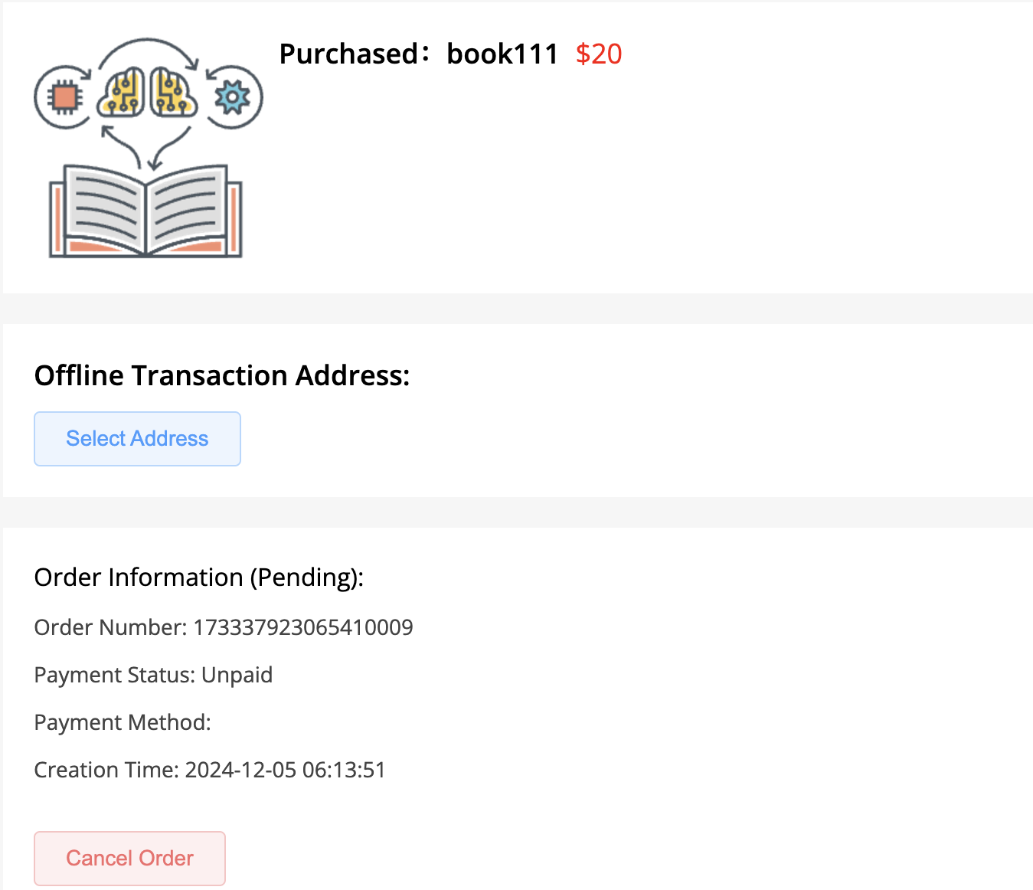
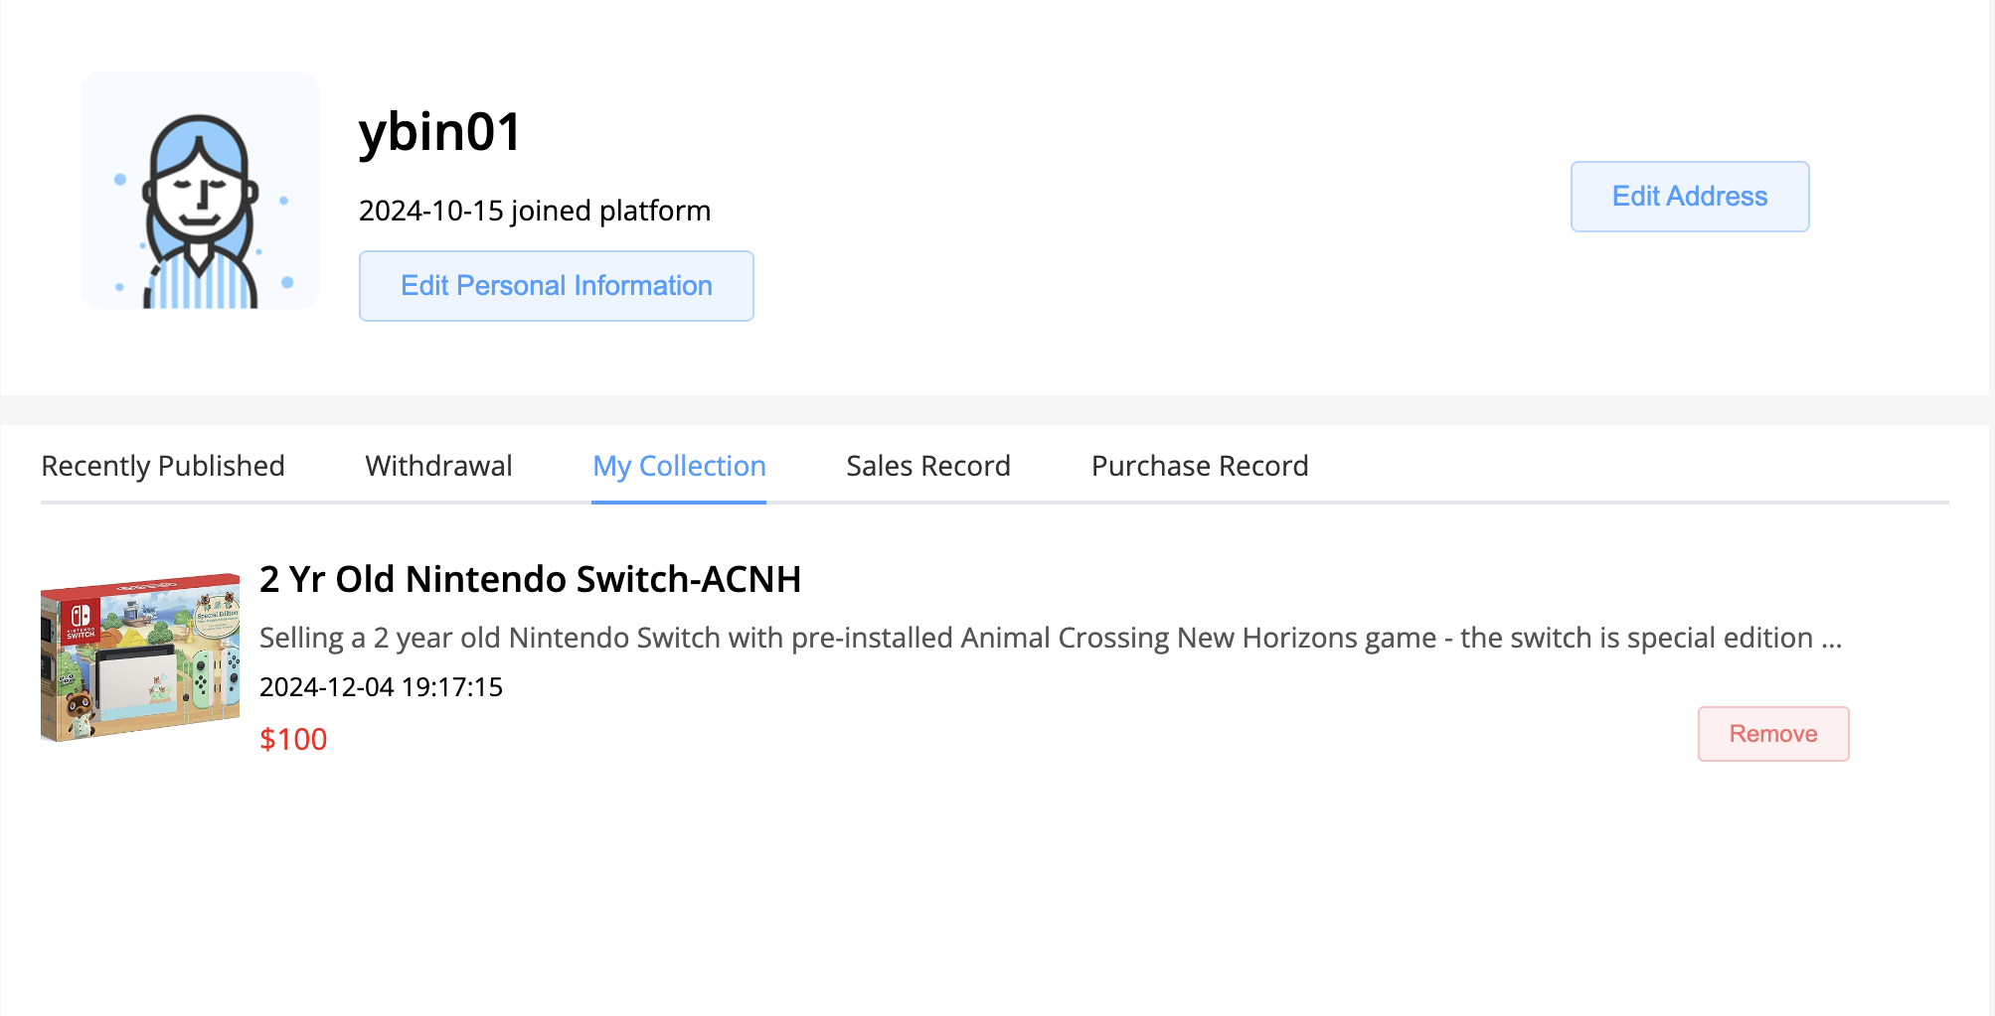
Project Fulfillment @Yuanbin
Users can access, search, list, post, favorite, buy, and sell and cancel orders for items. Additionally, we provide admin accounts for system management.
access
search
list
post
admin
cancel
sell
buy
favorite
Notes:
After three iterations, our system now allows users to access, search, list, post, favorite, buy, sell, and cancel item orders. Additionally, admin accounts are available for system management.(e.g. ban/unban user, online/offline items and cancel orders). Apart from the functionalities, our UI is quite user-friendly and pretty nice.

Slide 7
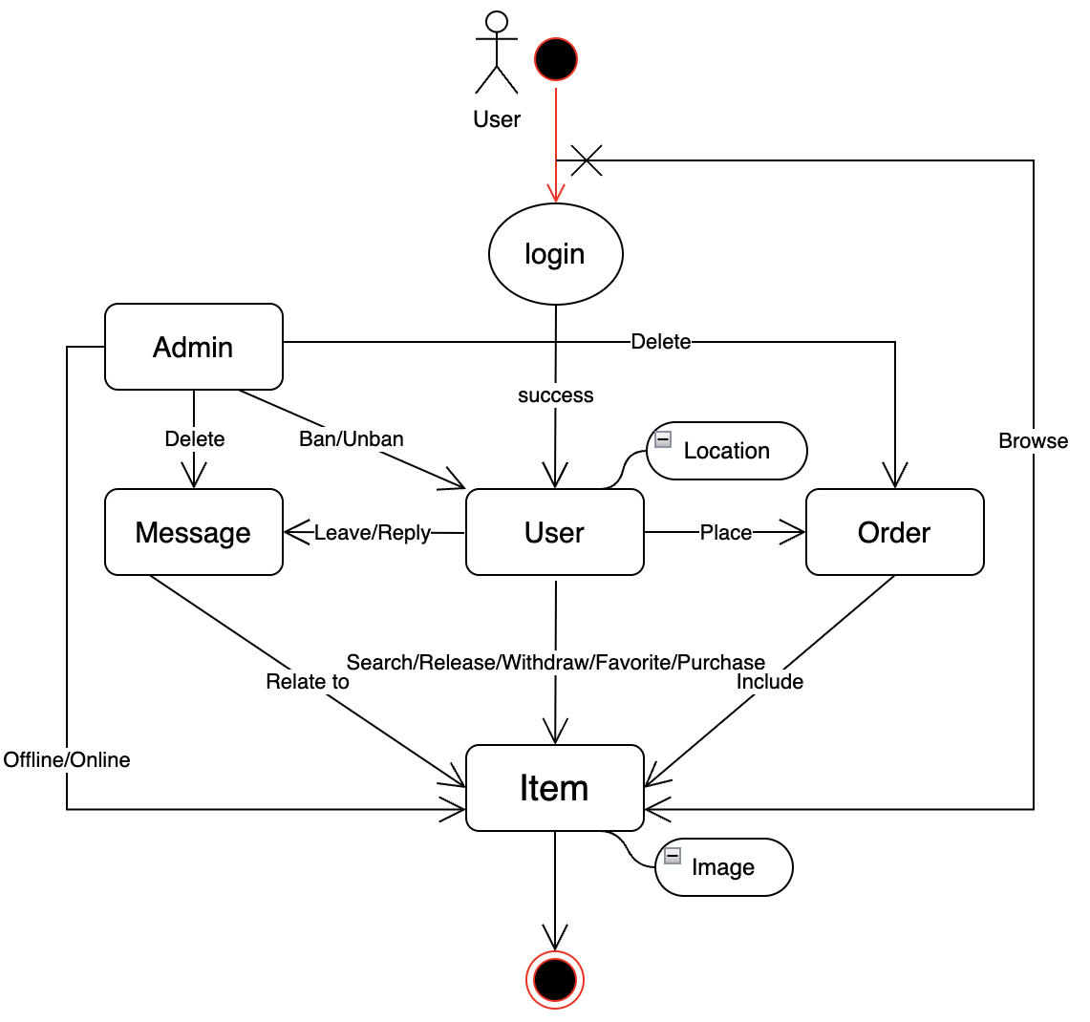
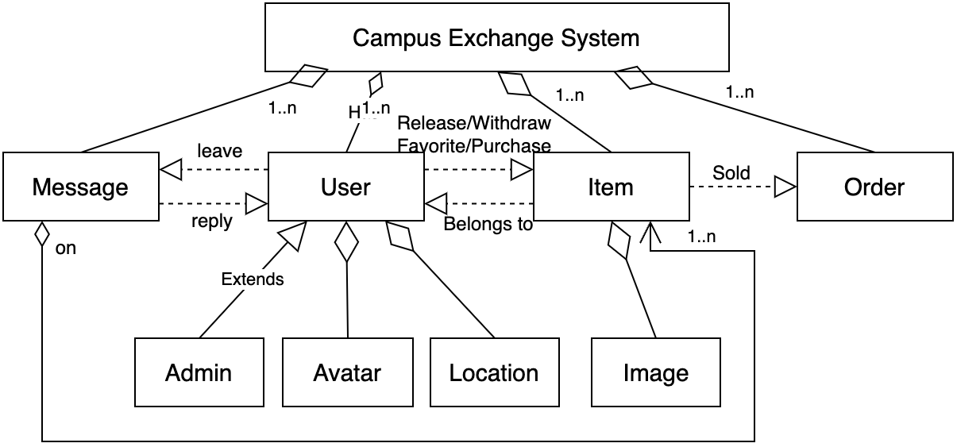
System Design @Yuanbin
(2) Class Diagram
Non-functional req.: usability, reliability, high performance,
and security; CI/CD;
(1) UI Flow
Notes:
The next part is system design. I believe we covered it in detail during the last iteration, so I’ll focus on highlighting some key points. First of all, I believe we have built a complex and robust system. As shown in the UI flow and class diagrams, we have several key components, including user, item, order, and communication. Here, I want to emphasize that, due to the large number of images in our system, we need to develop a highly efficient image service for items and user avatars. Additionally, we have built a task scheduler to handle asynchronous tasks.Apart from the functionalities, we also have several non-functional requirements, including usability, reliability, high performance, and security, as well as CI/CD. I will have Allen provide an introduction to these parts.

Slide 8
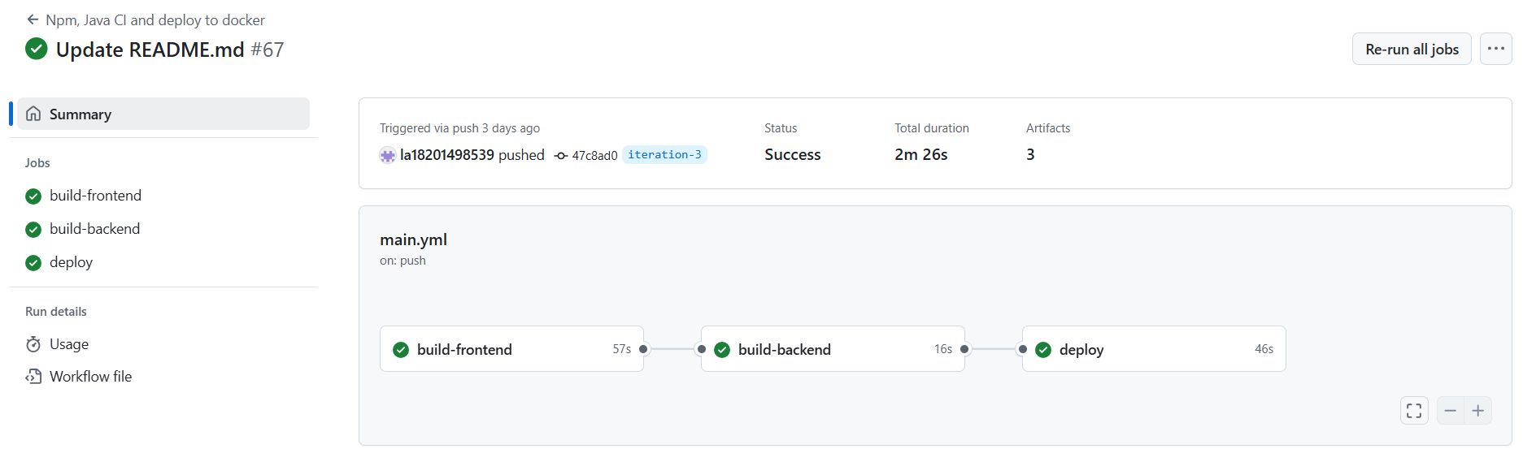
Deployment - CI @Allen
GitHub Action
Build the frontend
Move the built frontend and build a jar
Use the jar to build a docker image and upload
Notes:
talk about what to improve in the future
Use 2 docker files for development and production
Upload the production docker file directly to the ali cloud
add automatic test into the action to ensure there is no bugs in the docker image.

Slide 9
Deployment - CD for version1
resolve environmental dependencies
git pull the code
Server
bash script
build & package
start frontend
start backend

Slide 10
Deployment - CD for version-2
webhook
github action for CI
alicloud API
CD start
github
hub.docker.com
K8S
cluster
push
complete!
always pull the image
create an extra pod
and then deploy the container
CD complete!

Slide 11
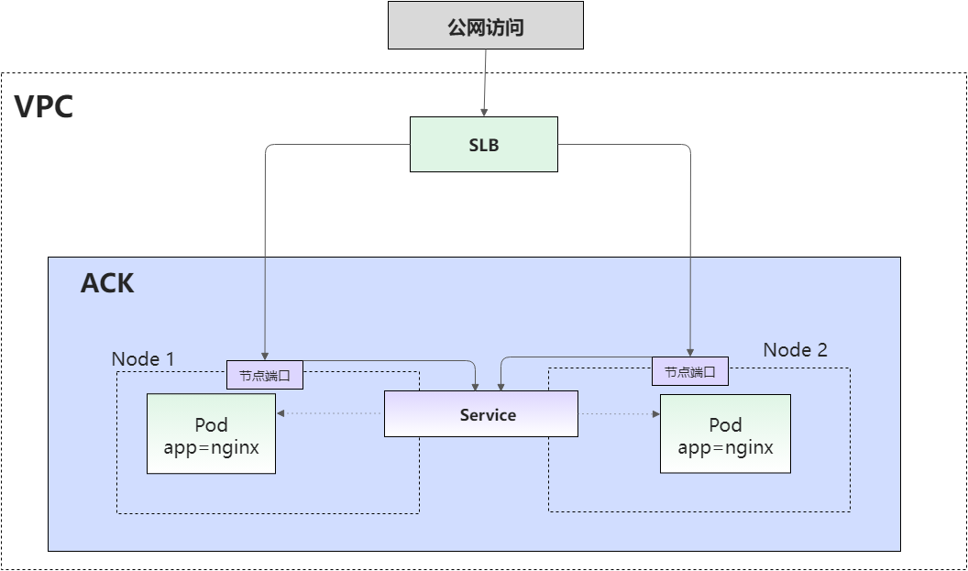
Deployment - network architecture
Creation and Allocation
Traffic Forwarding
Configuring Routing and Health Checks

Slide 12
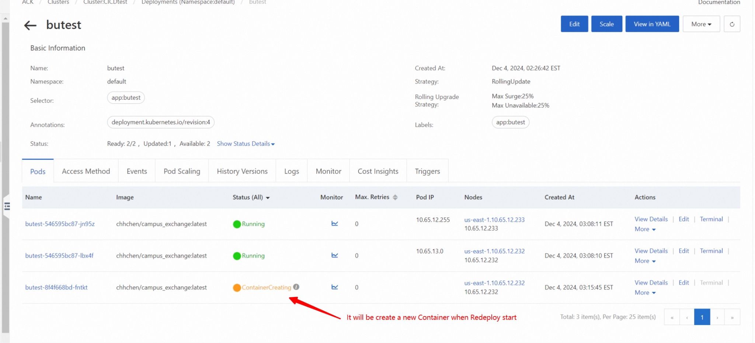

Slide 13
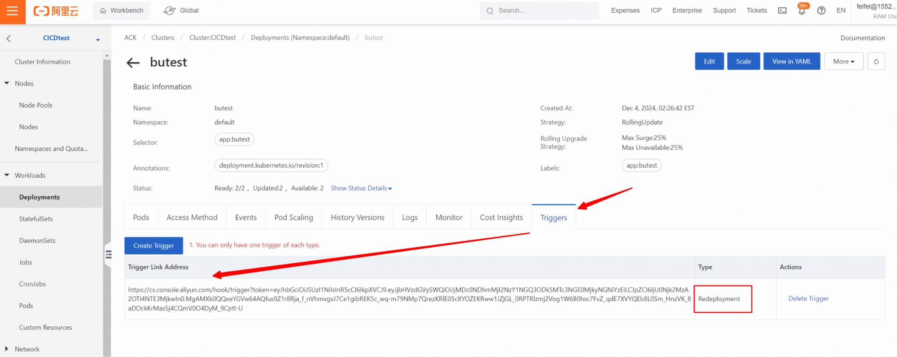

Slide 14
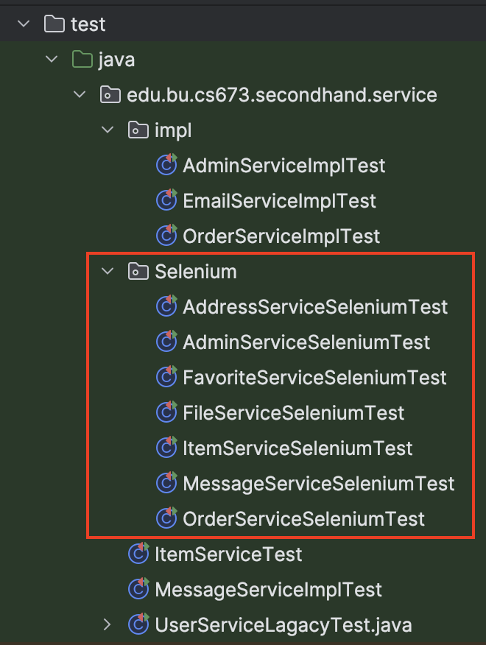

QA Processes and Tools Used
Automation Testing: Initially, Selenium automation tests focused on one core service. As the project evolved, we expanded the scope to cover most of the other services, ensuring comprehensive test coverage across the application.

Slide 15
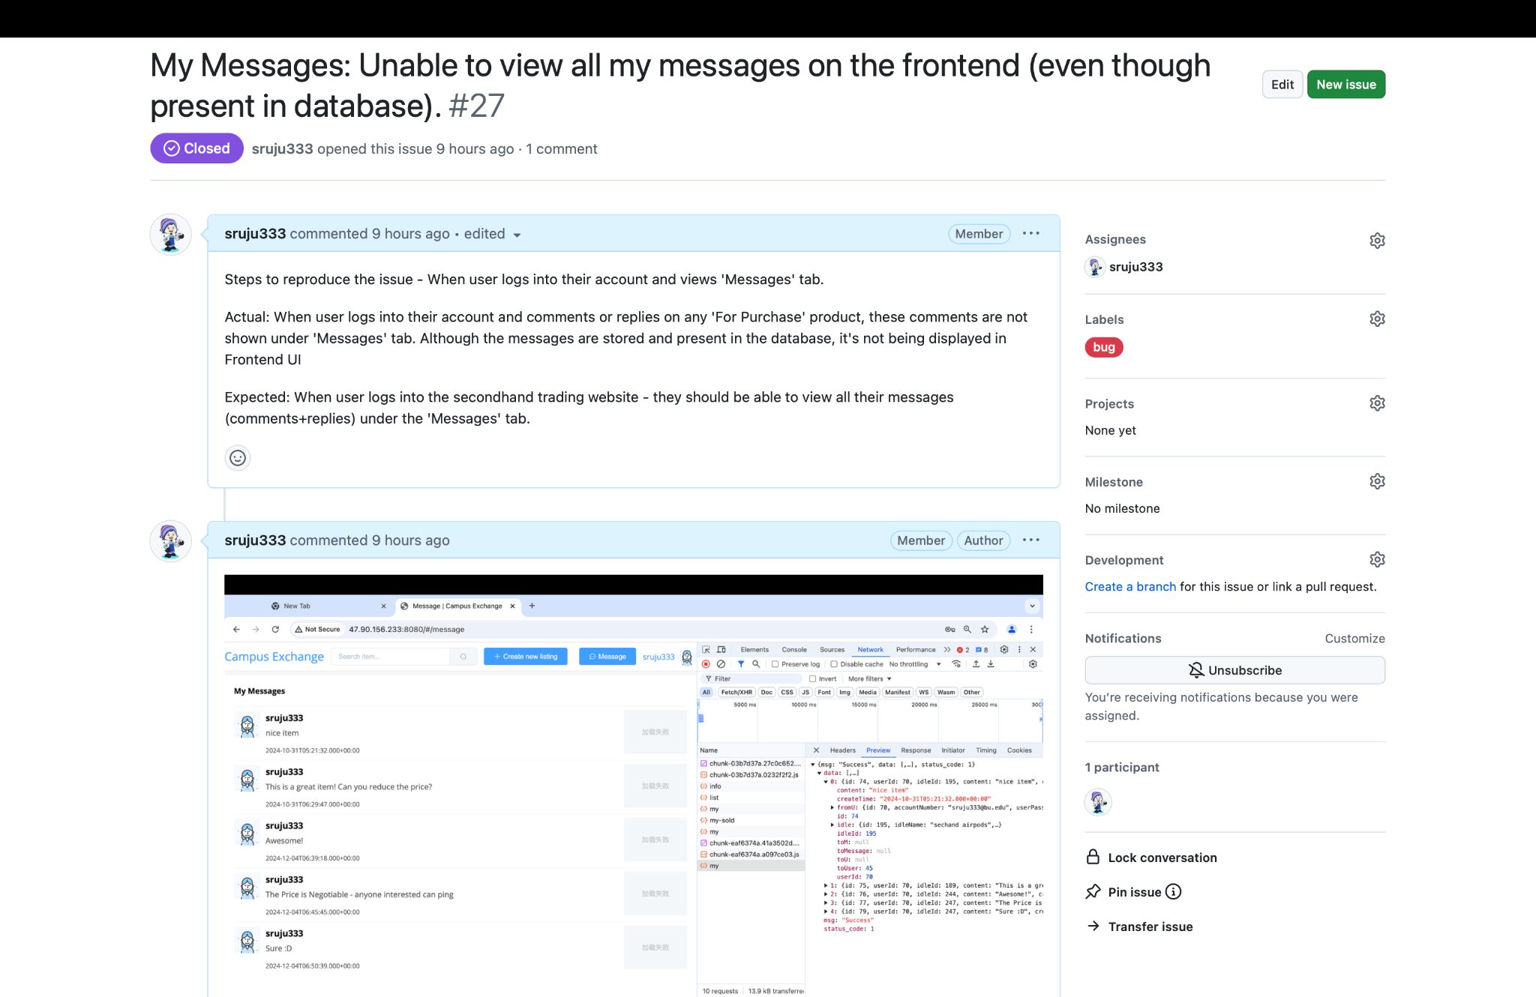
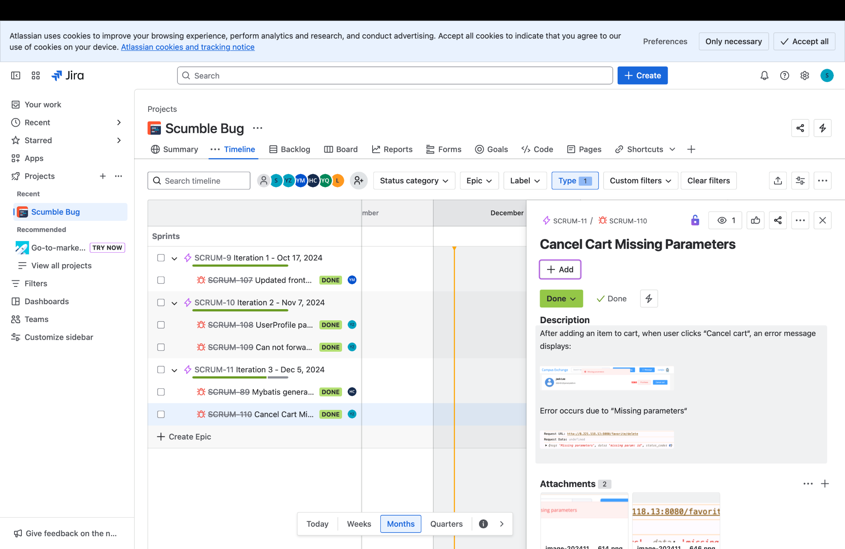
Continued…
Defect Management: We used GitHub Issues & JIRA to systematically track and manage defects. Every identified bug was logged, discussed, and assigned for resolution. For instance, during the latest deployment, we identified and closed 3 critical and 10 minor issues using this process.

Slide 16

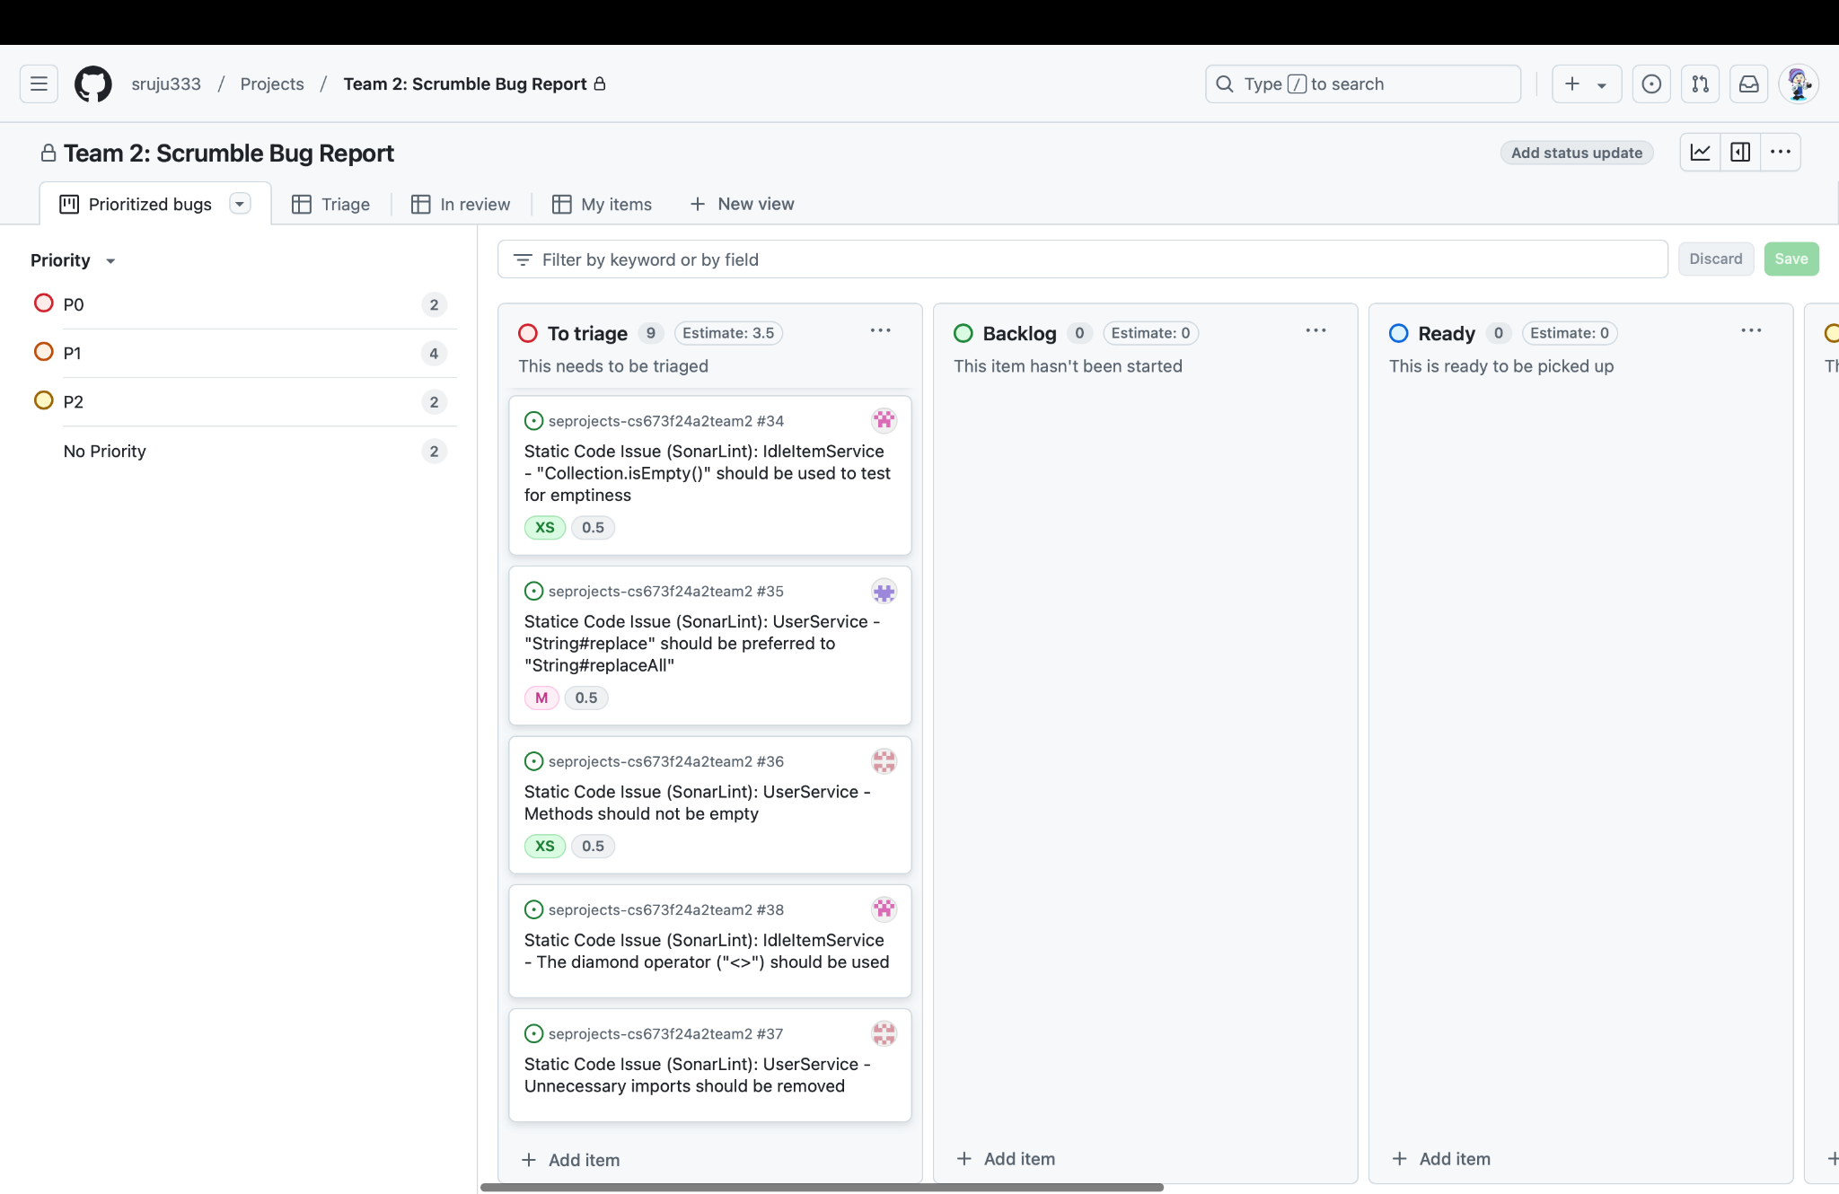
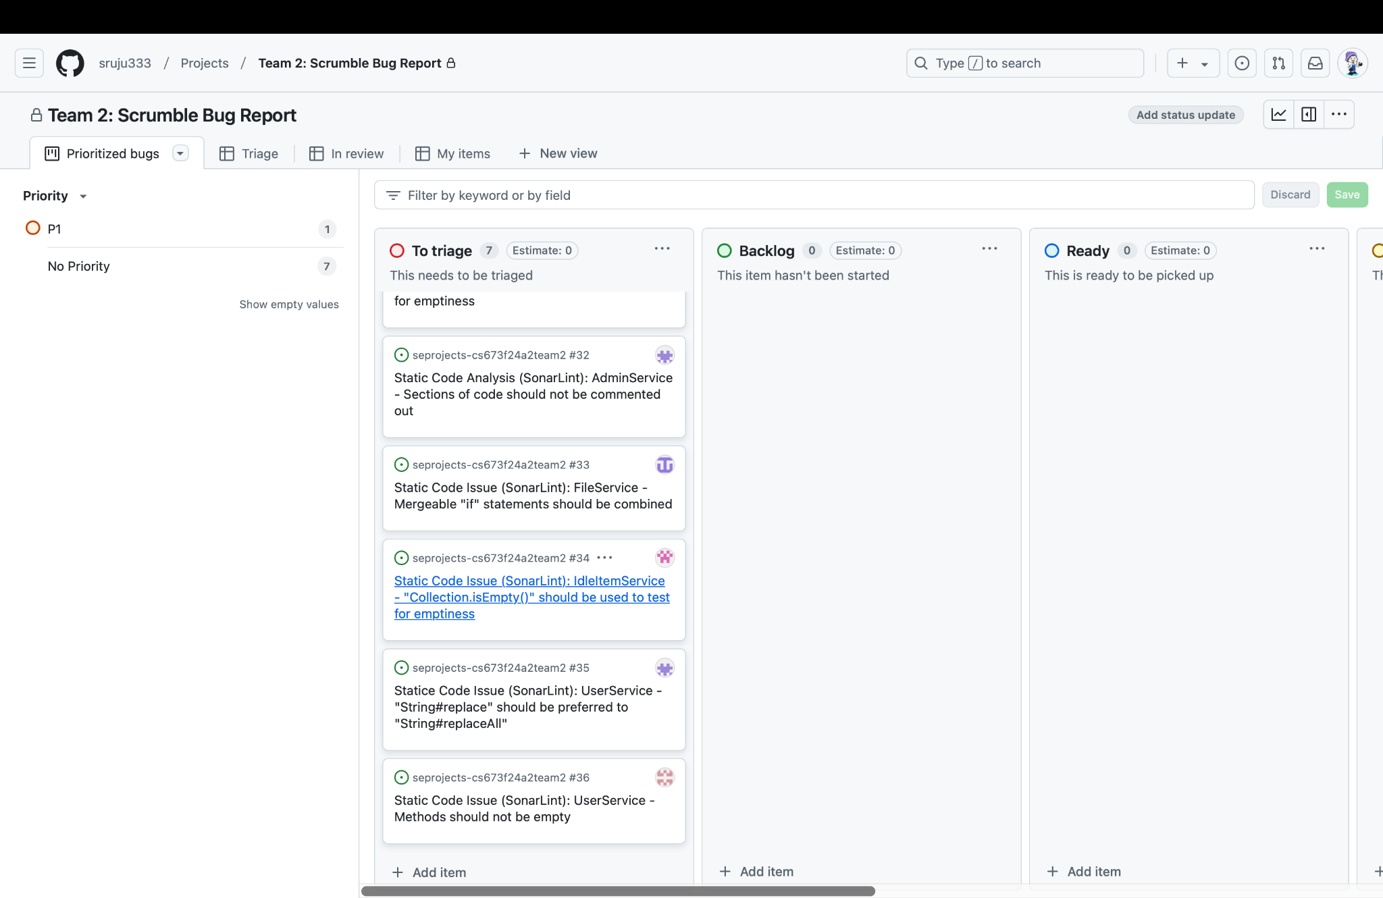
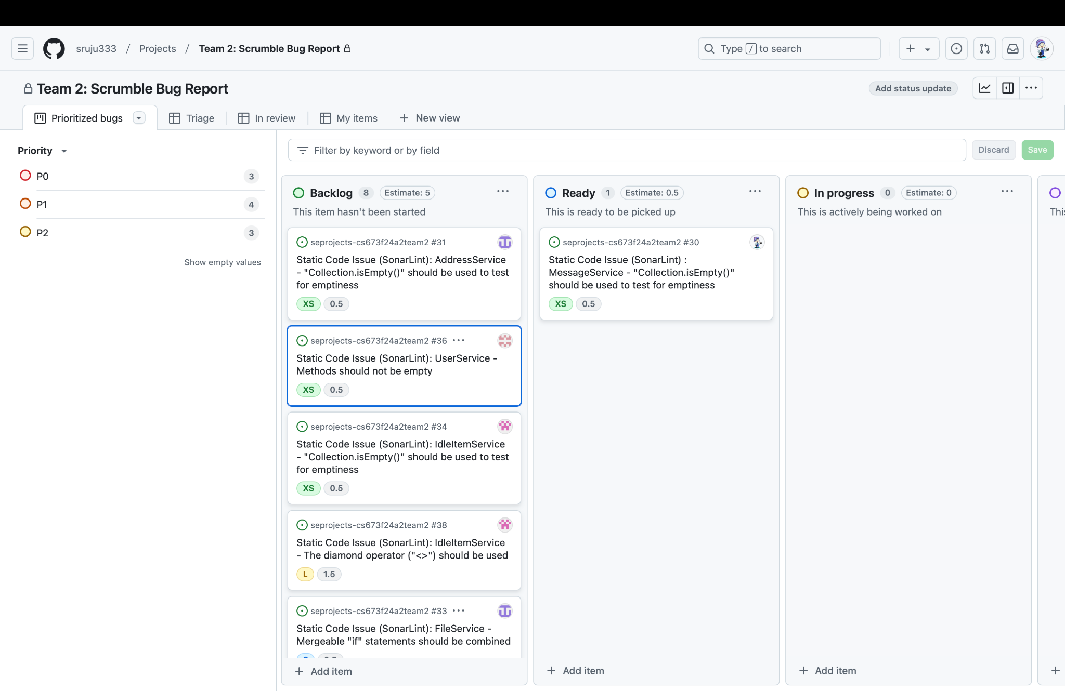
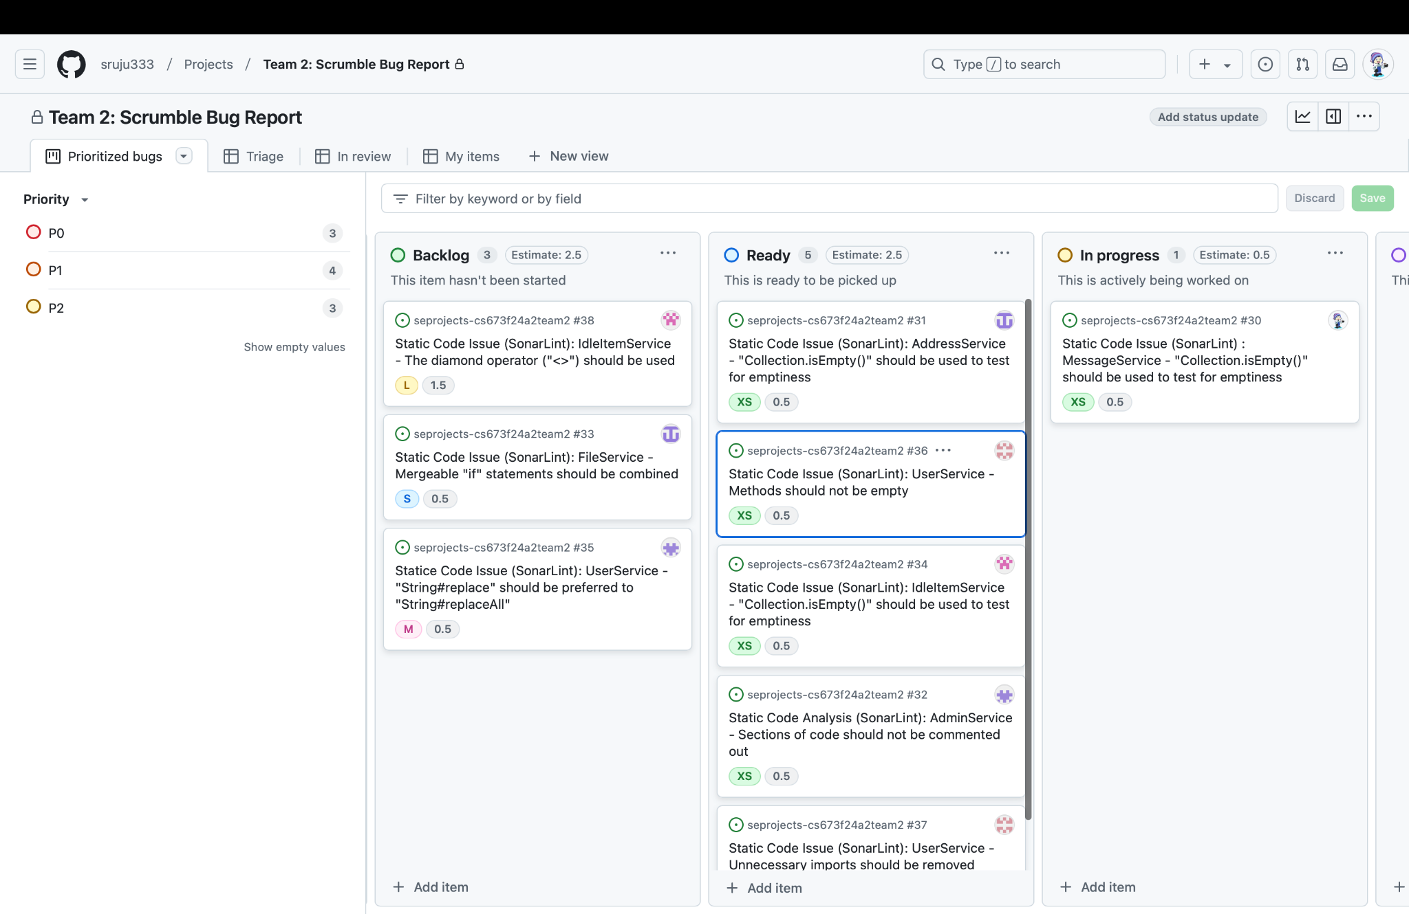
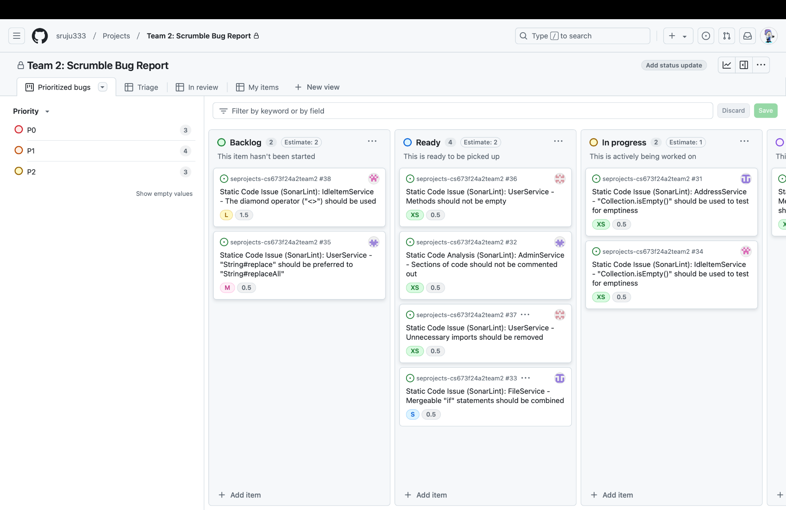
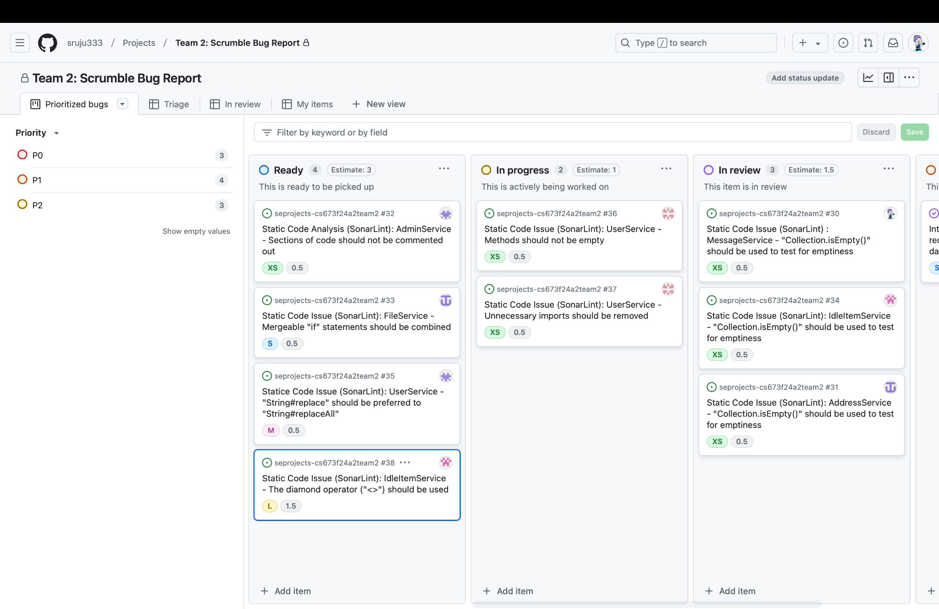
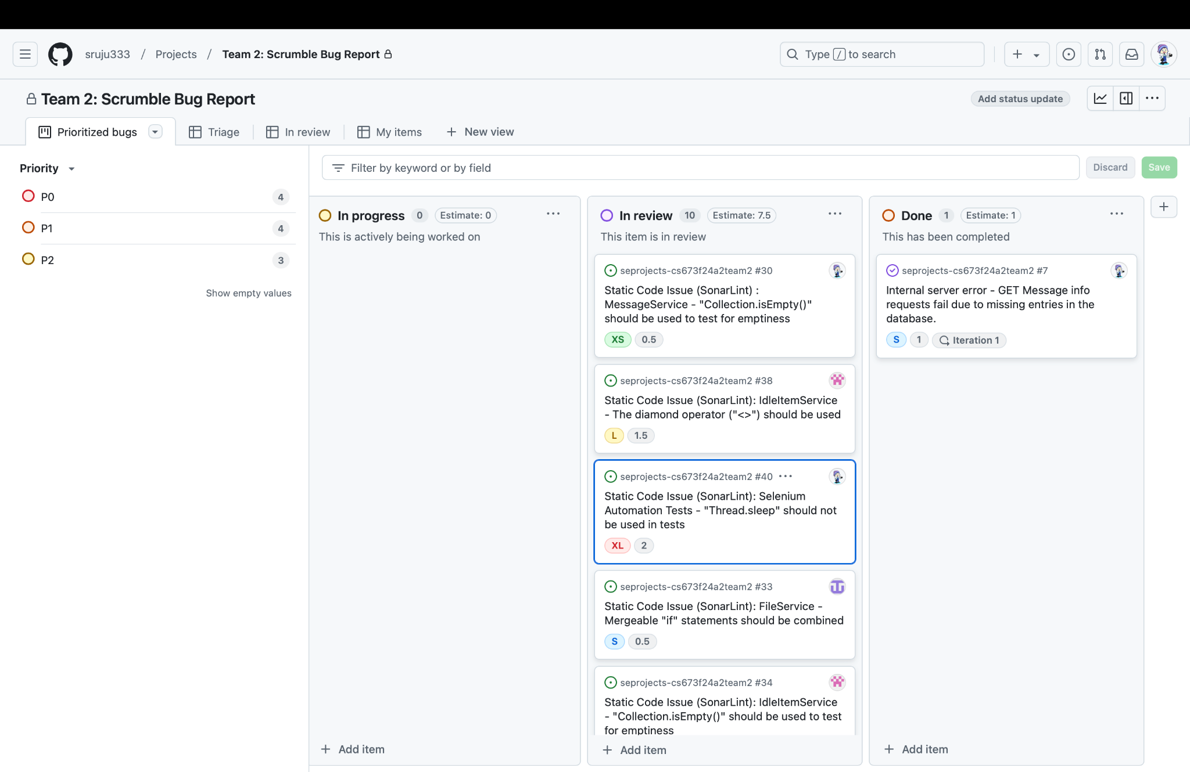
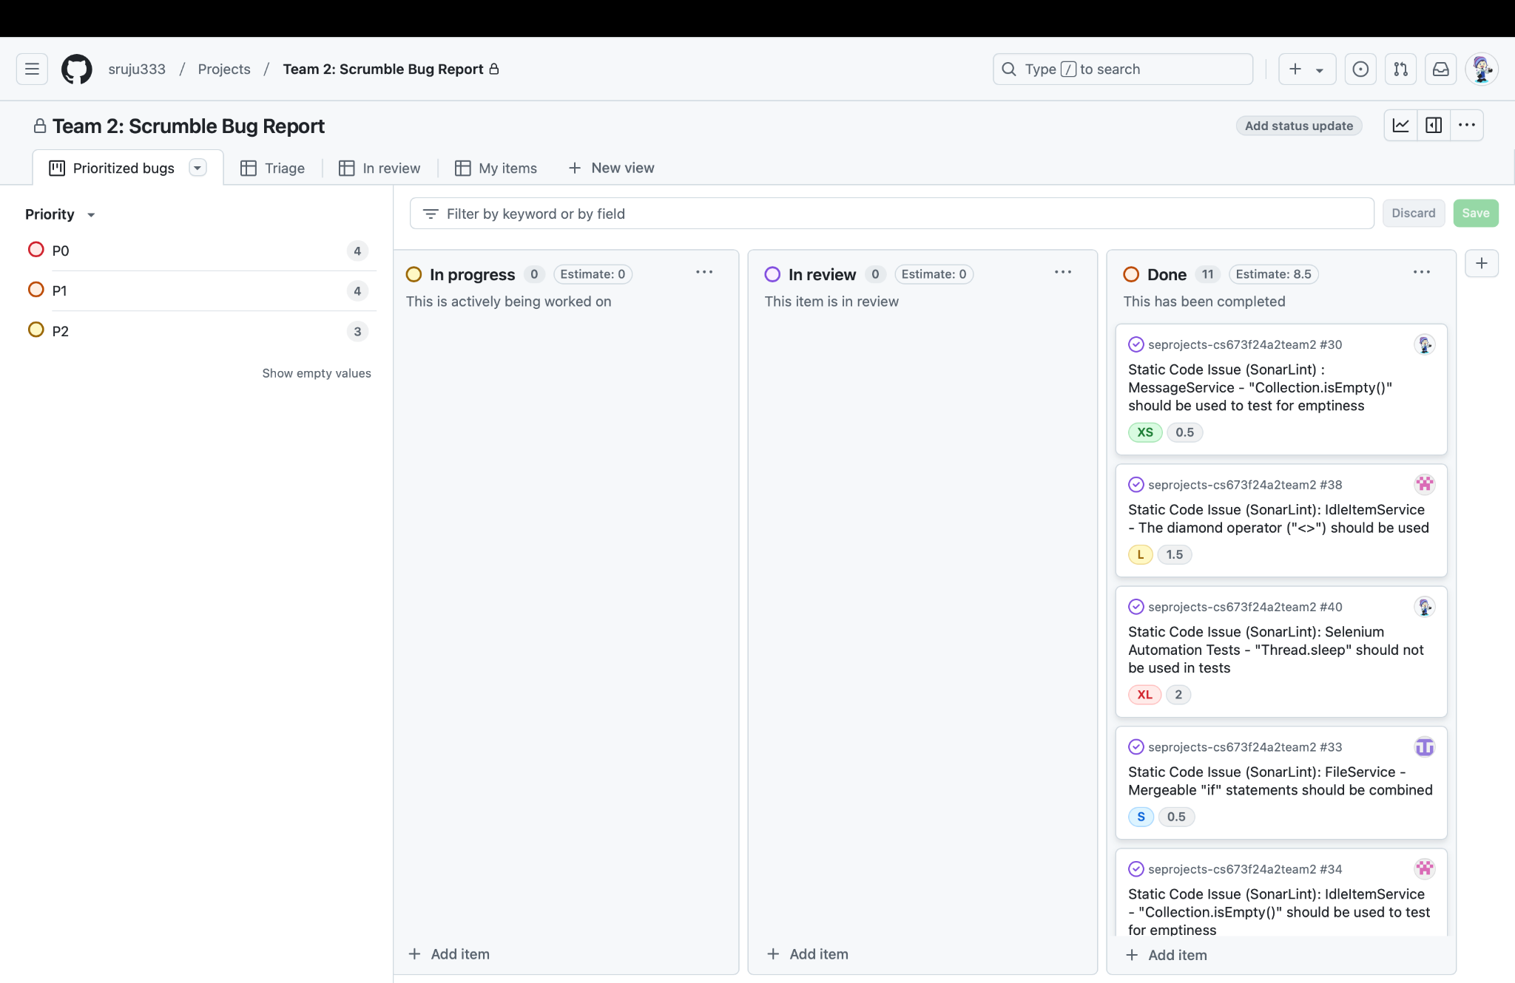
Static Code Analysis using SonarLint

Slide 17
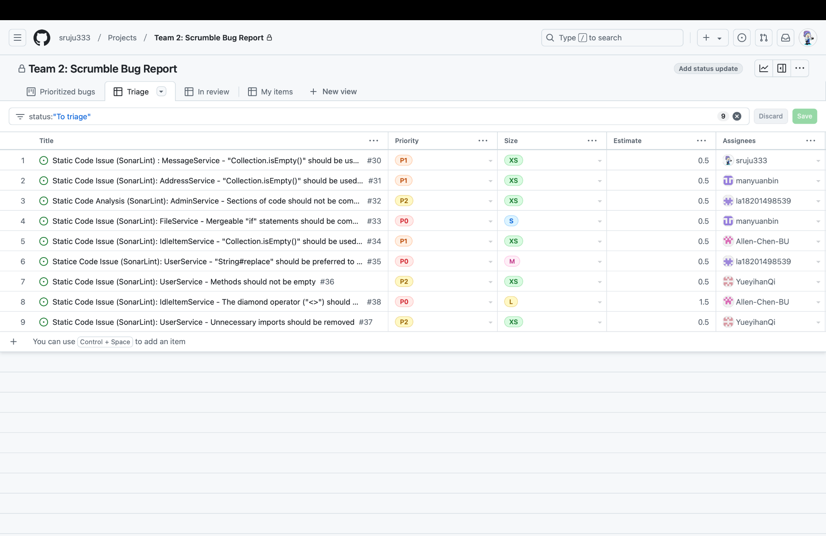
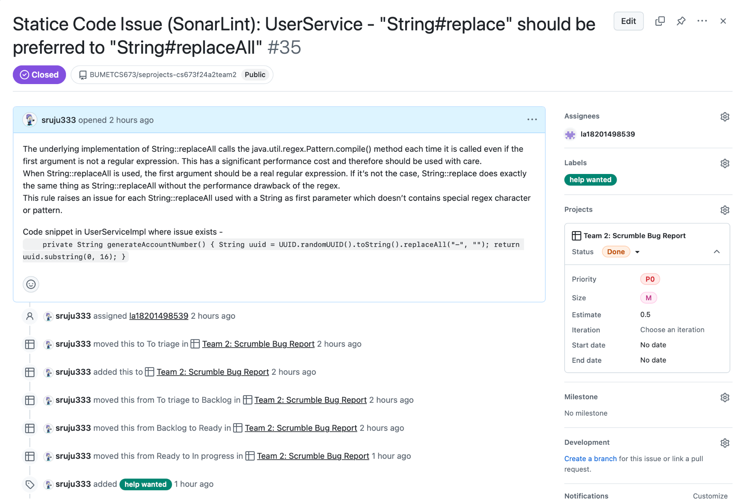
Github Issues - Bugs and Code Quality changes

Slide 18
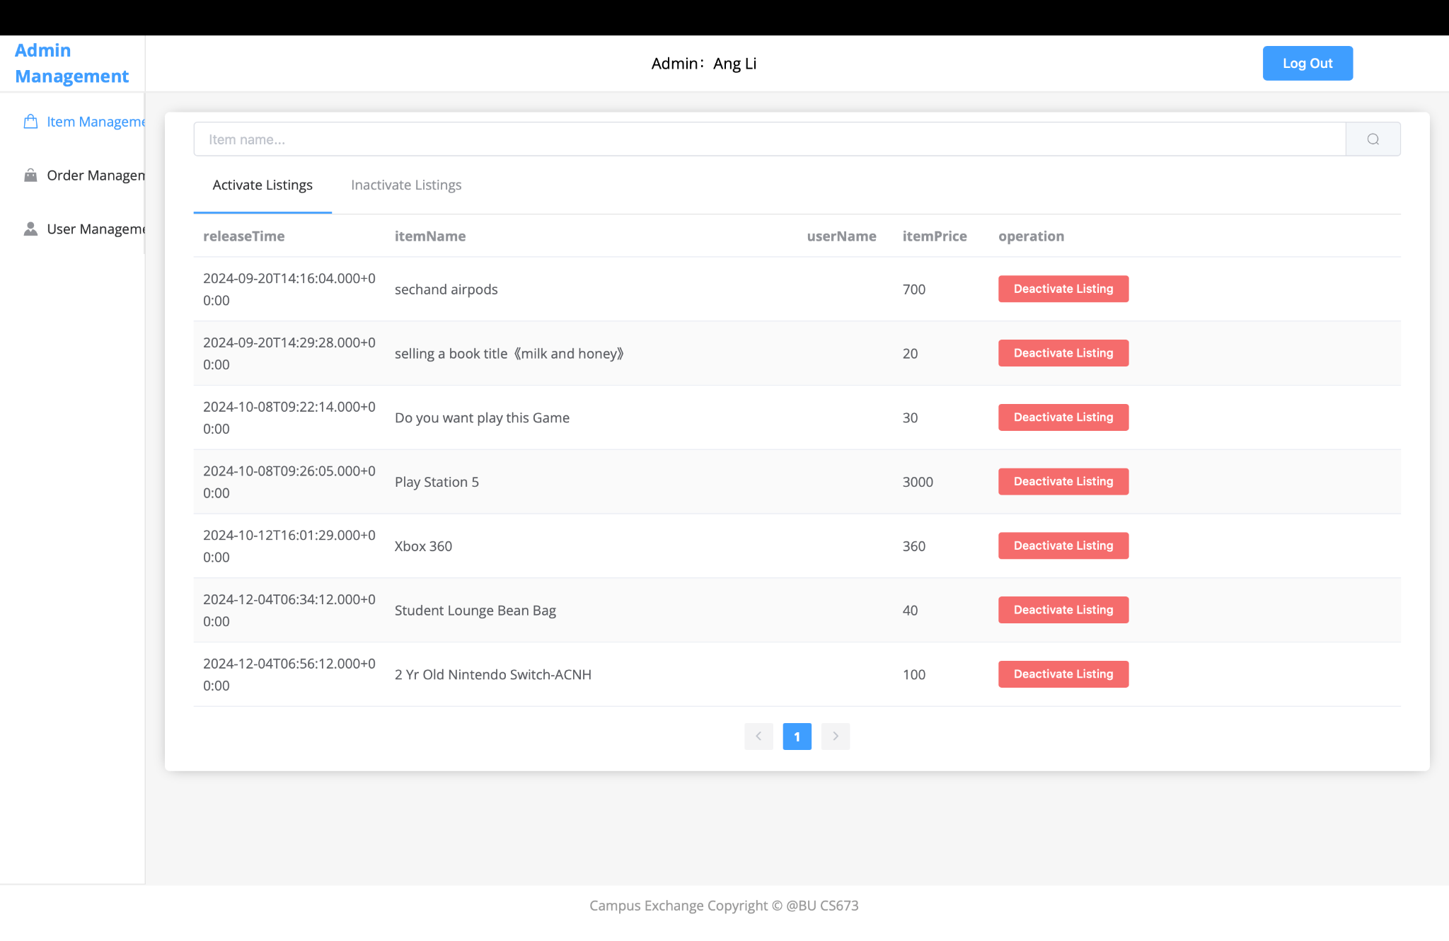
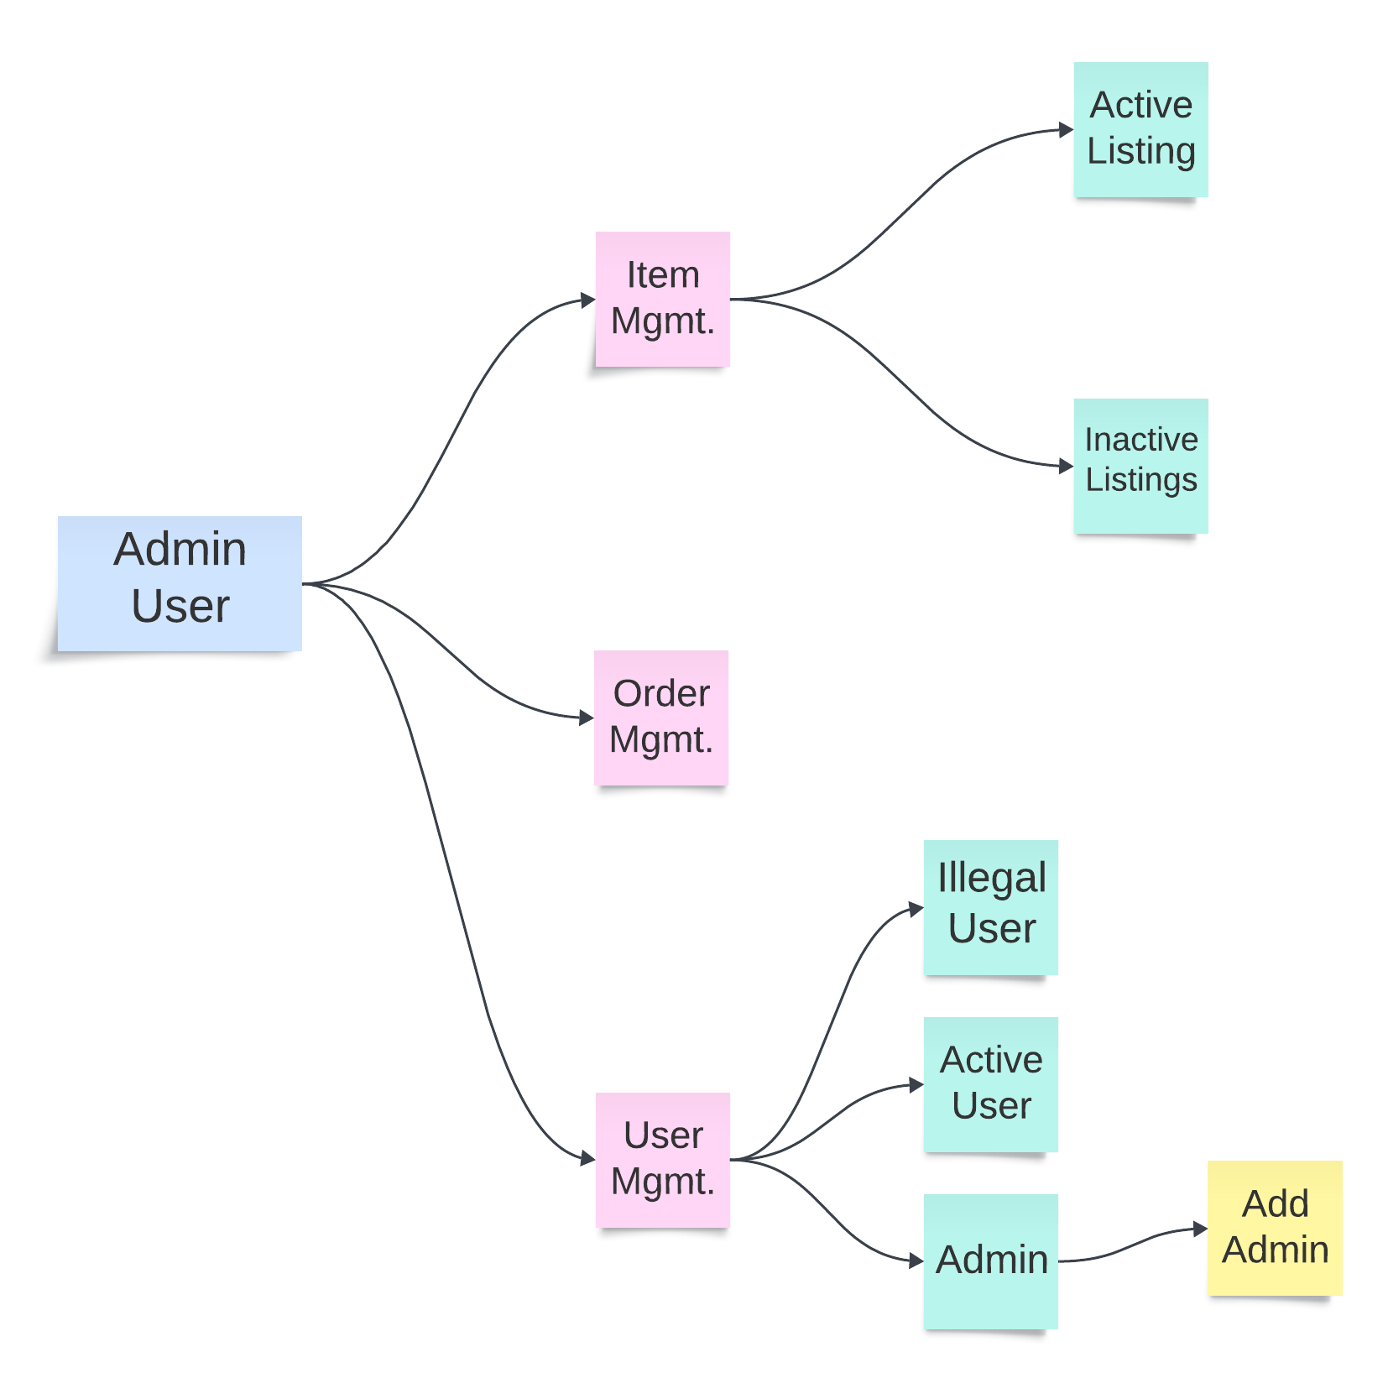
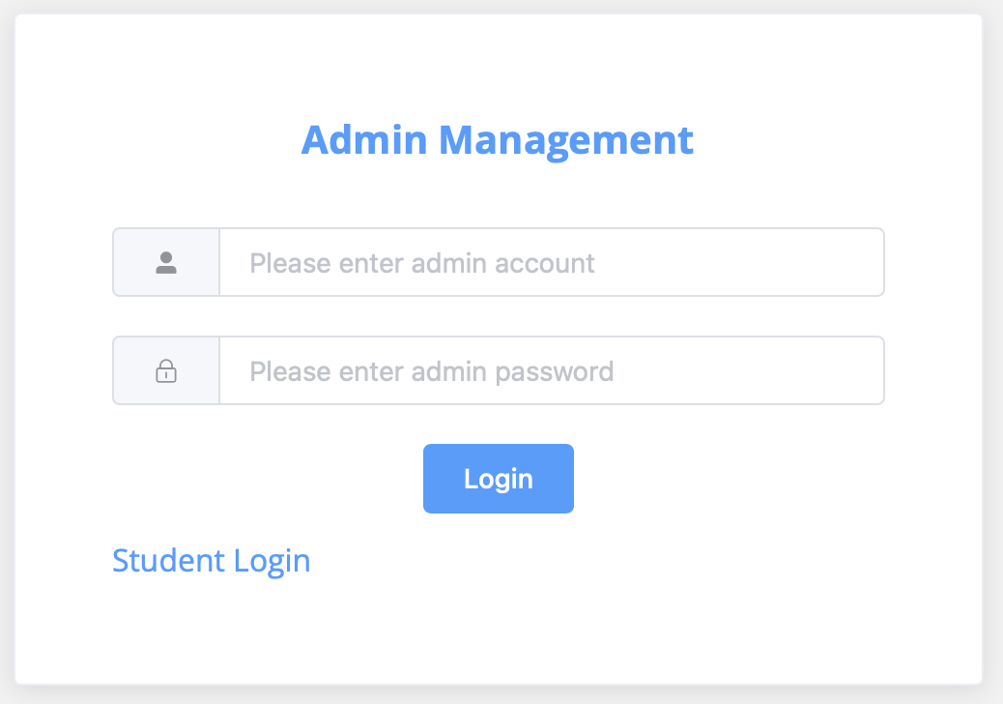
Admin User - System Testing

Slide 19
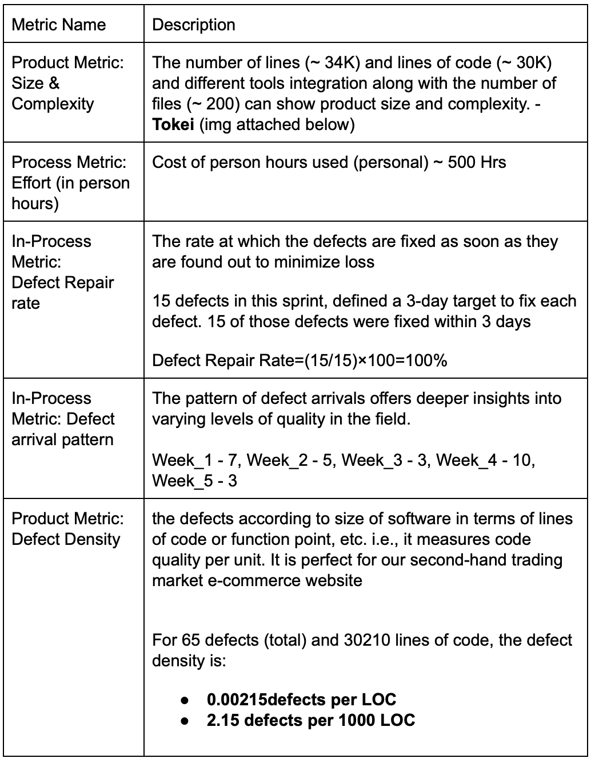
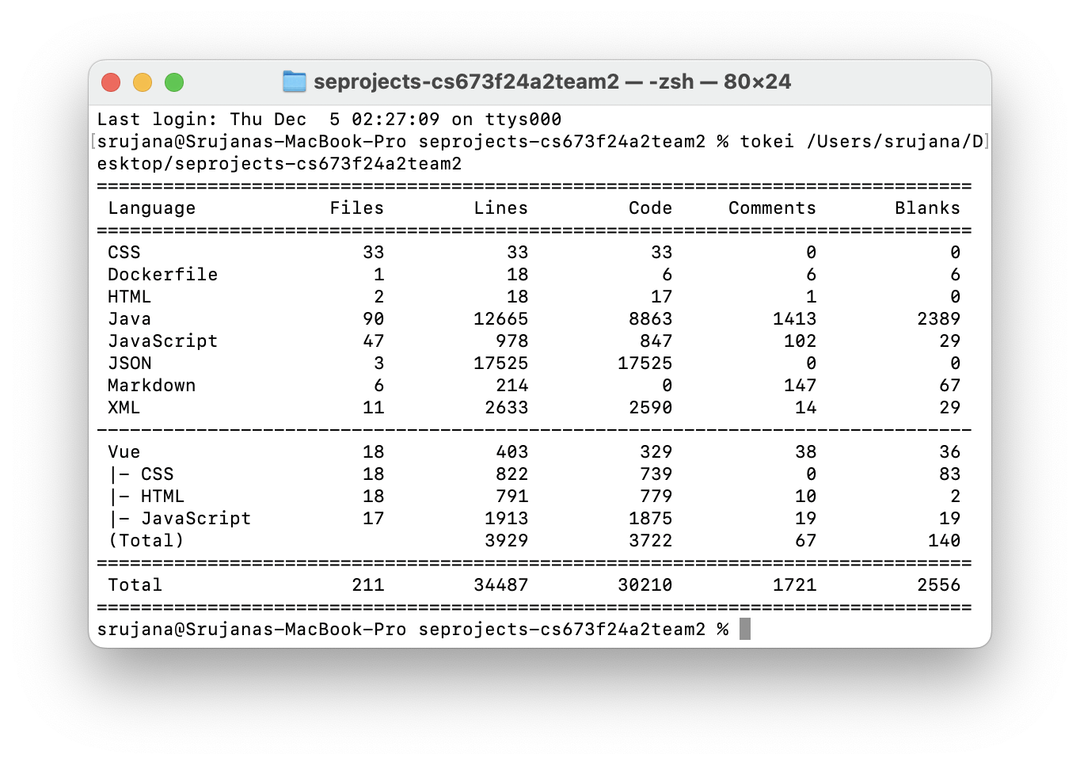
Test Metrics (Final)

Slide 20
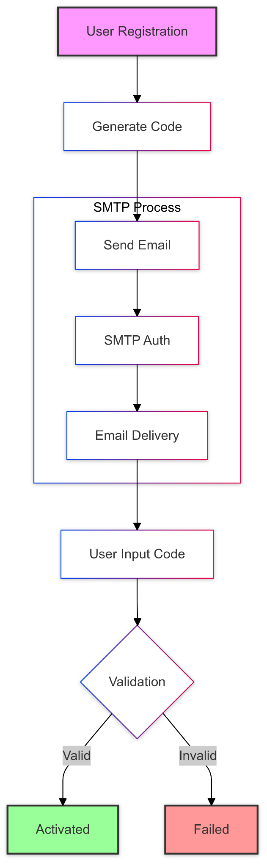
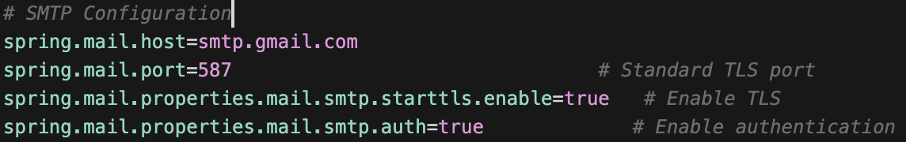
User Authentication
Secure SMTP email verification
6-digit verification codes
TLS encryption for data security
Real-time validation
Notes:
security implementation and risk management strategy

Slide 21

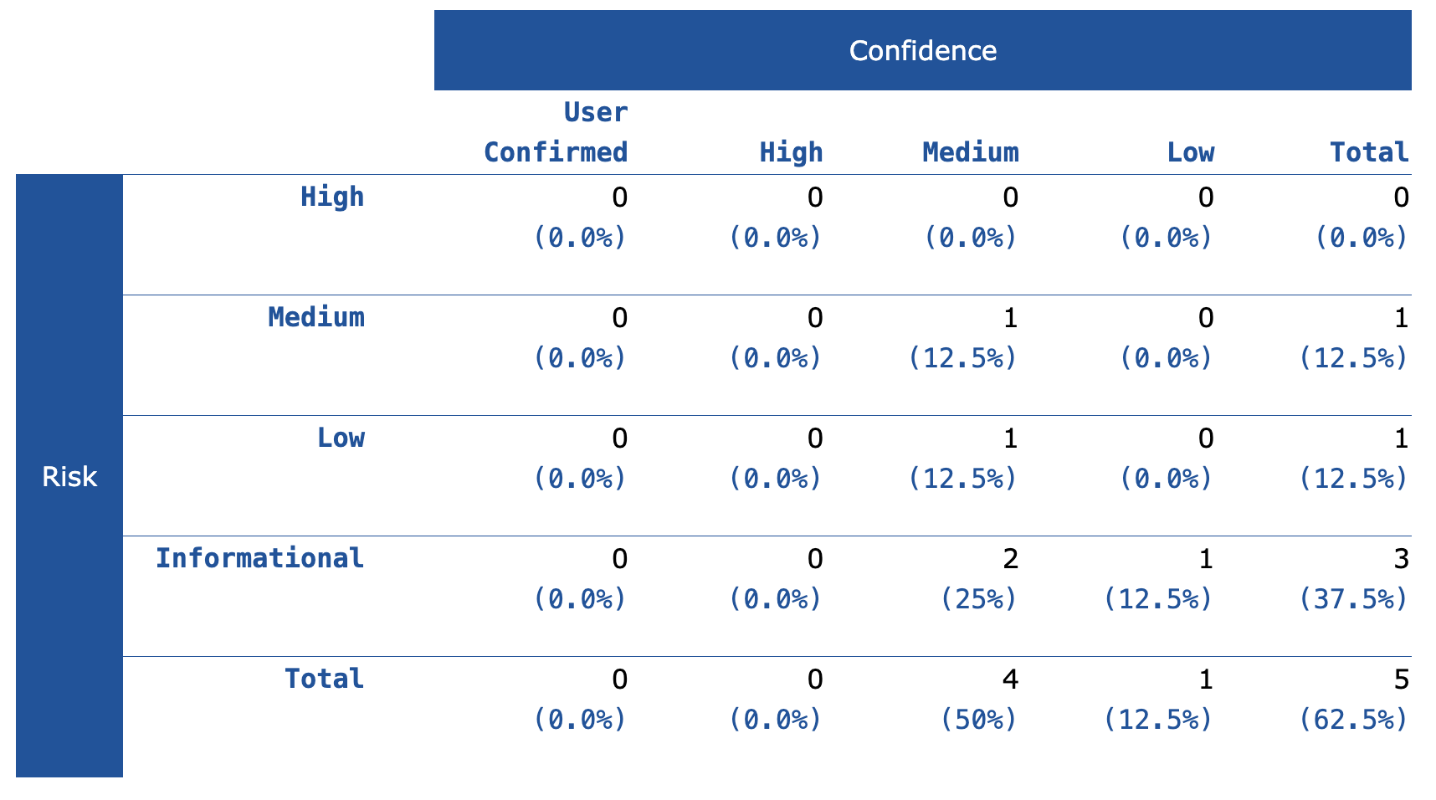
Security Scan Results Overview

Slide 22
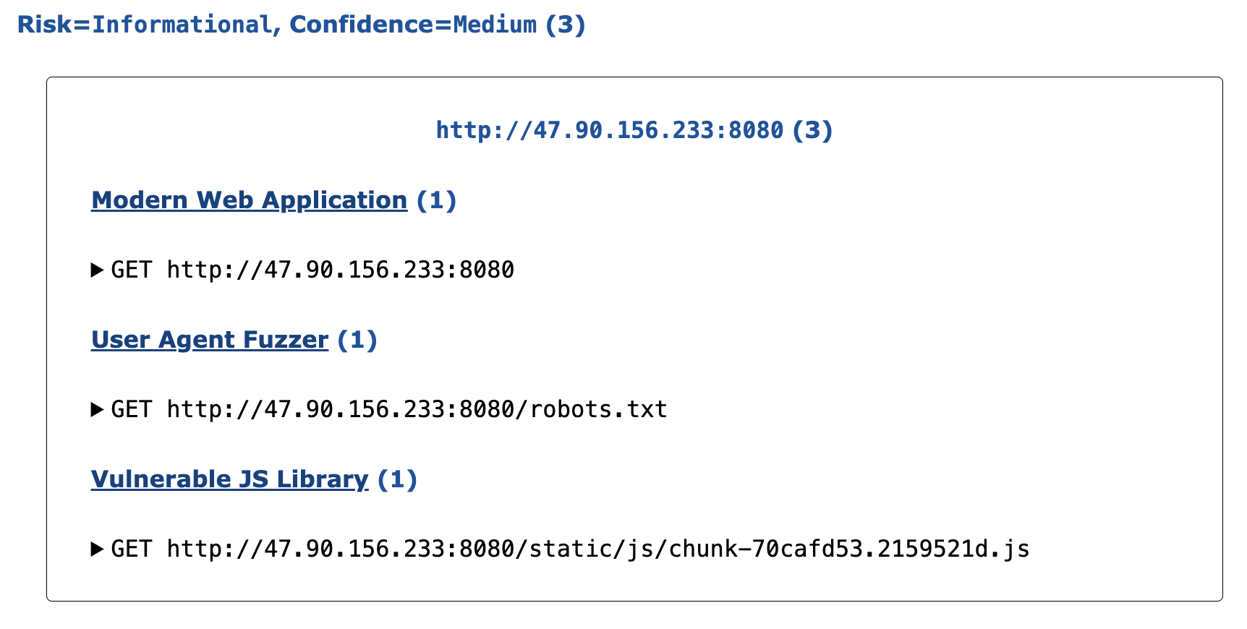
Notes:
modern web application detection: using port 8080
user agent fuzzer check: standard stuff about our robots file
javascript library detection: third-party dependencies
doesn’t affect our security
informational alerts with medium confidence
0 high risk issue
maintain good security practices with minor issues detected

Slide 23
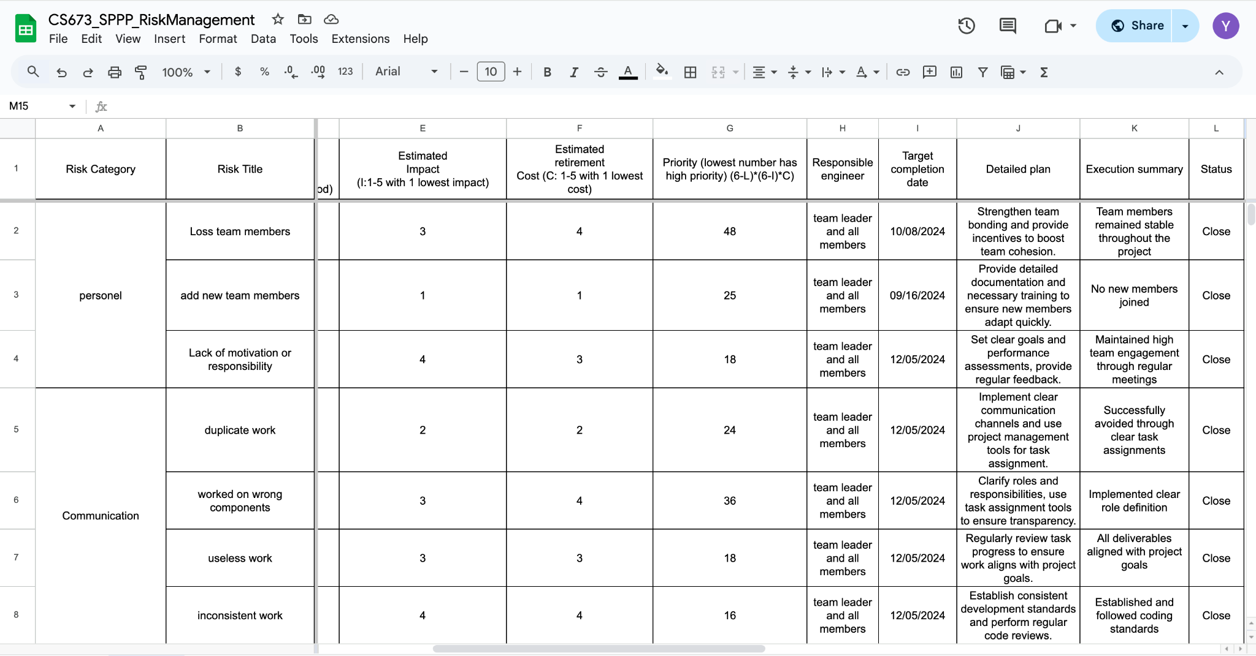
Risk Management
Notes:
Our team has stayed together throughout the project
Whenever we hit technical challenges, we just did some training
If requirements changed, we handled them right away
And we're always keeping an eye on security
now All our identified risks are now closed - which means our strategy is working perfectly!

Slide 24
Demo
https://drive.google.com/file/d/1OW8JnK1BVSVMWshY5GssWRIRRAYWItSP/view?usp=sharing

Slide 25
Thank you!

